Slide 1
Ottawa
By darius

Slide 2
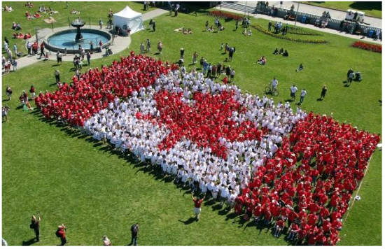
Population in Ottawa is 870 250

Slide 3
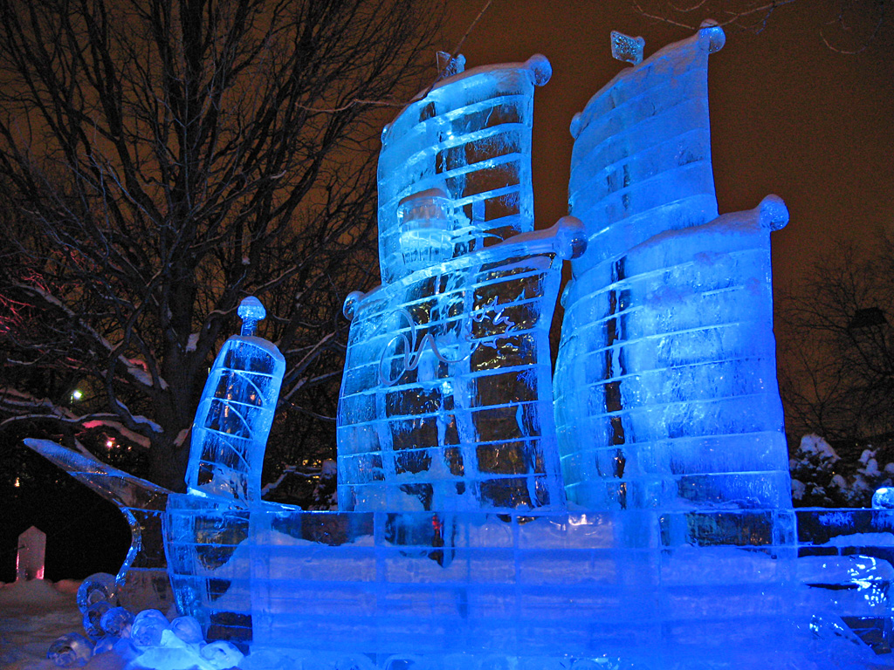
Climate inOttawa
It is very cold in the winter. It can get down to -20 degrees Celsius. in the summers it HOT. The temperature can get as warm as 30 degrees Celsius.

Slide 4
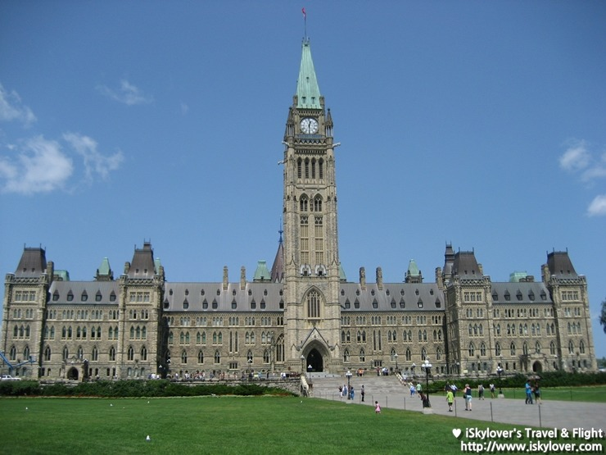
Does Ottawa have the parliament?
Yes it does . The paliament is where the government works

Slide 5
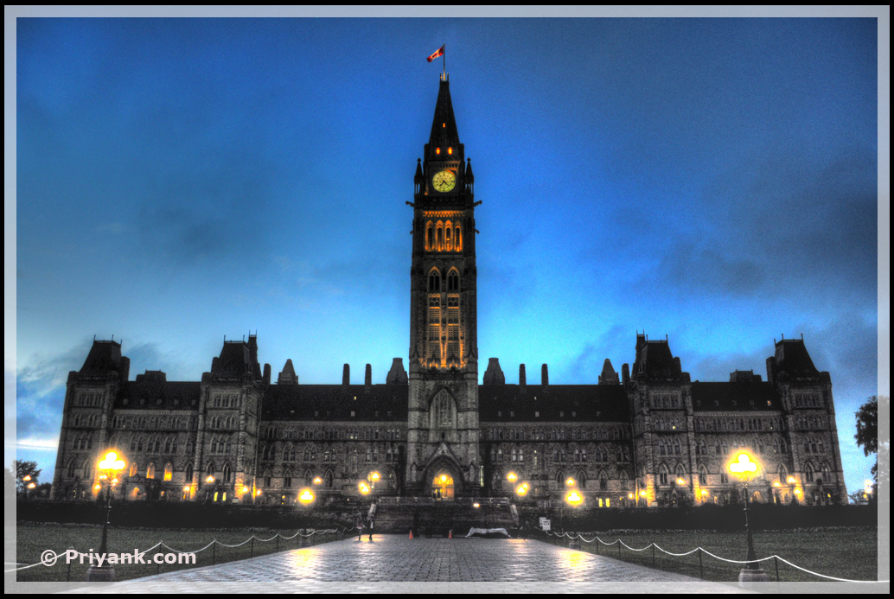
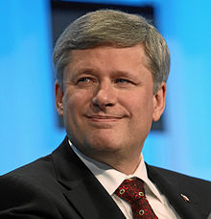
Jobs in Ottawa
there are lots of government jobs in Ottawa because it’s the capital of Canada .
Steven Harper. Prime Minister

Slide 6
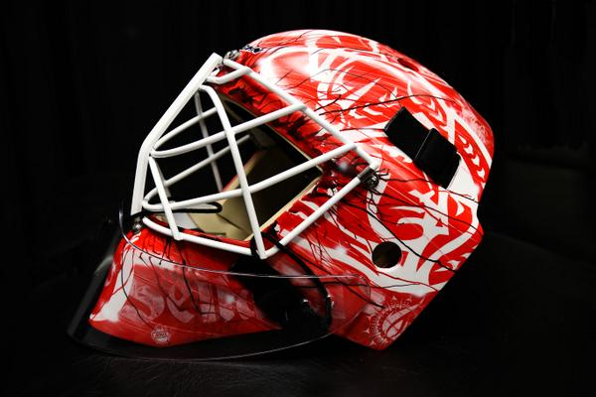
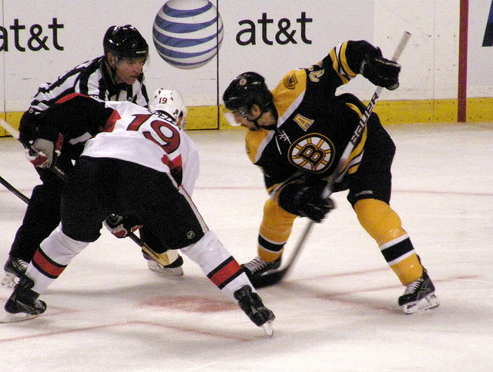
Top sport is hockey
Ottawa senaters

Slide 7
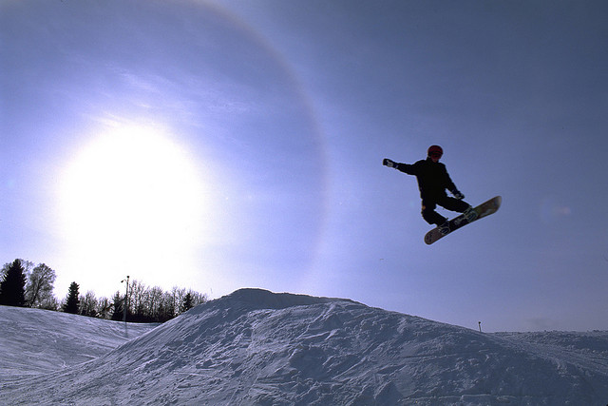
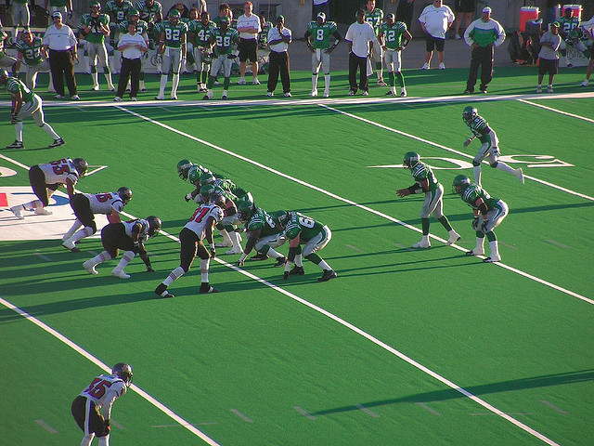
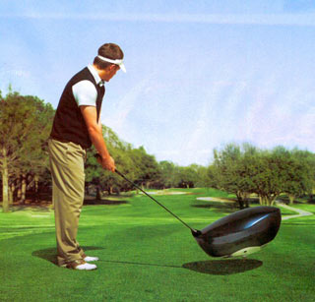
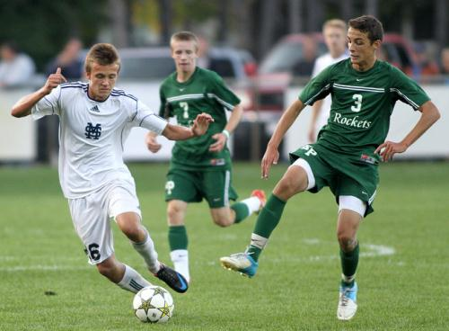
Other sports in Ottawa.
There are many different sports in Ottawa such as football ‘snowboarding golf soccer

Slide 8
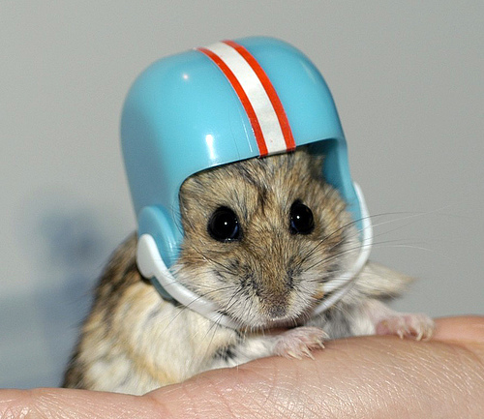
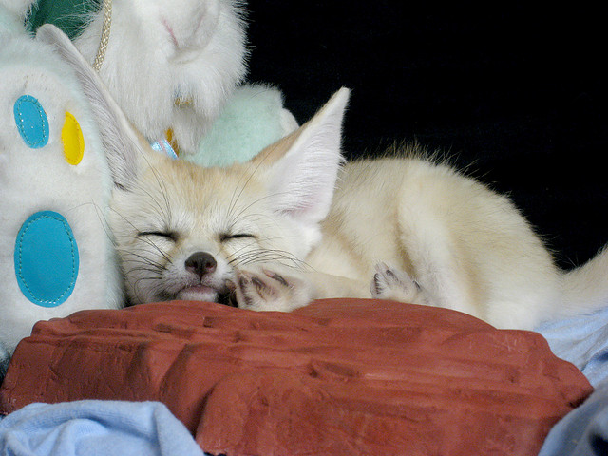
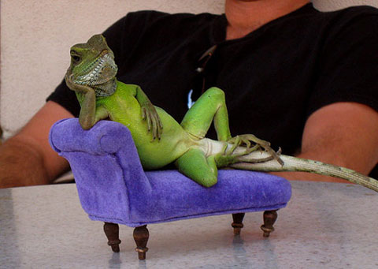
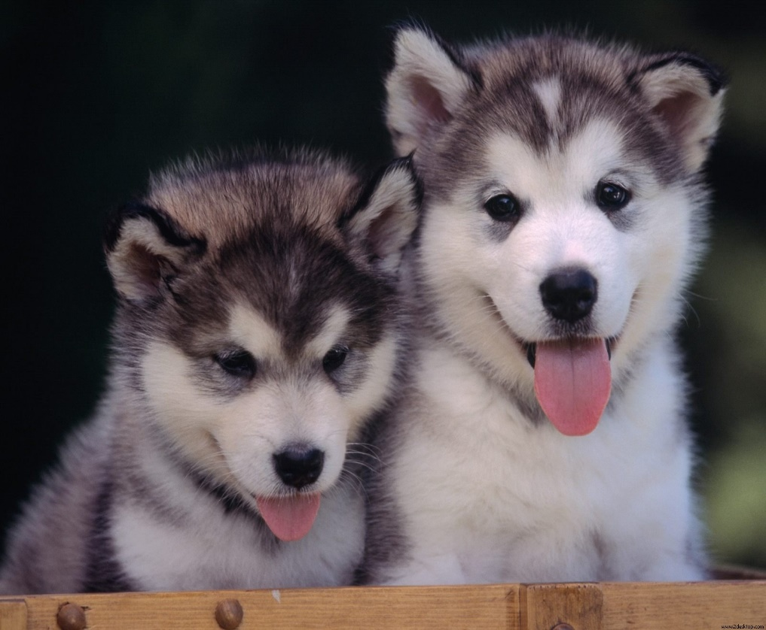
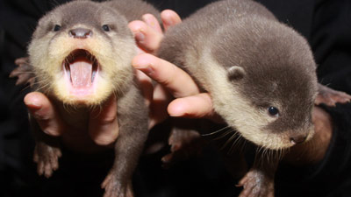
Animals in Ottawa

Slide 9
The end by Darius

