Slide 1
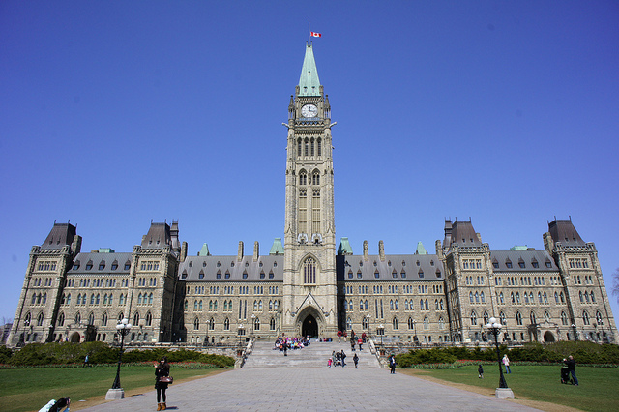
OTTAWA
Capital of Canada

Slide 2
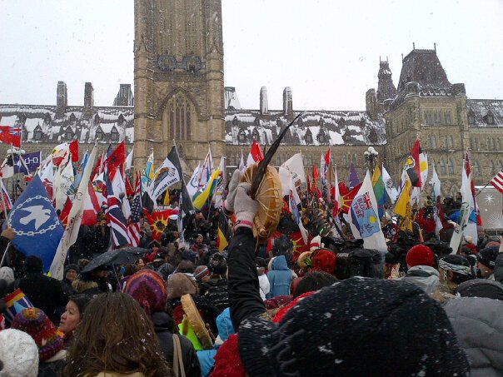
POPULATION IN OTTAWA
POPULATION IN OTTAWA IS 64,900

Slide 3
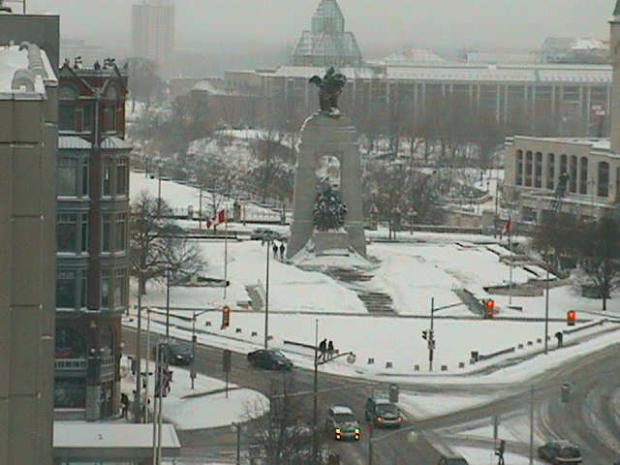
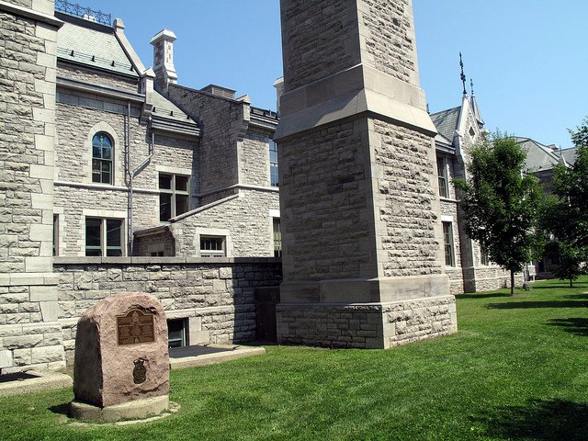
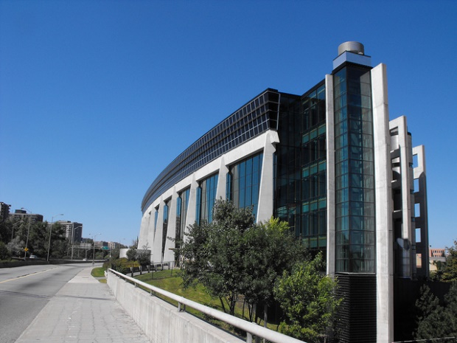
WEATHER
AVERAGE WEATHER IN JANUARY-5 C
AVERAGE WEATHER-16.C
Average weather in summer-25c

Slide 4
SPORTS
THERE ARE ICE HOCKEY,FOOTBALL,BASEBALL,SOCCER,AND MORE

Slide 5
LAND Ottawa is in the St Lawrence lowlands .the St Lawrence lowlands his good soil for planting

Slide 6
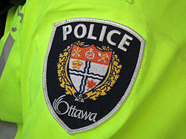
JOBS
BUS DRIVER
TEACHER
Government
POLICE
FIREFIGHTER AND MORE

Slide 7
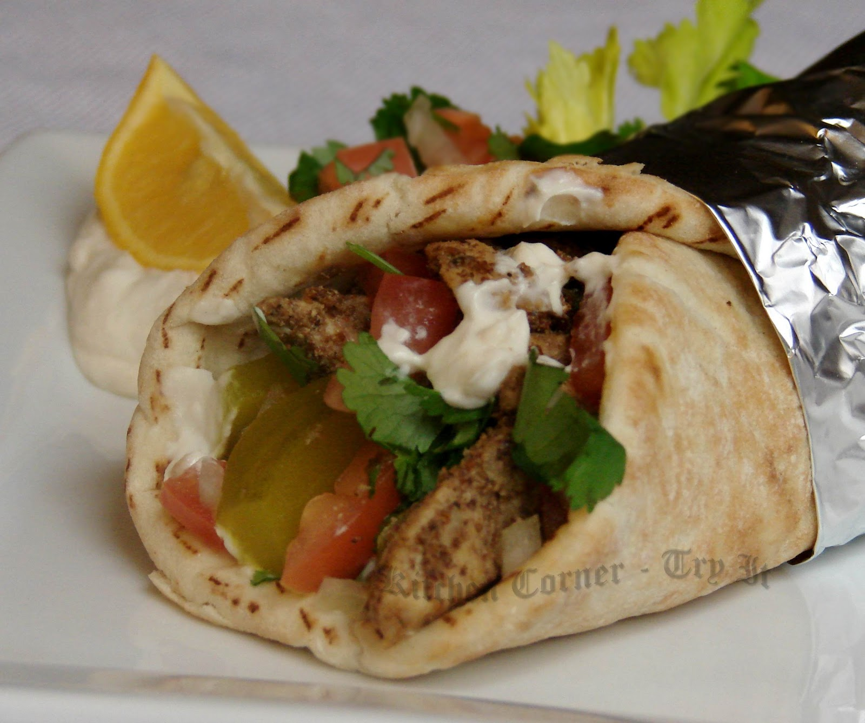
FOODS
Shawarma is a popular food in Ottawa. It is because there are a lot of Lebanese people in Ottawa. This dish is from Lebanon

Slide 8
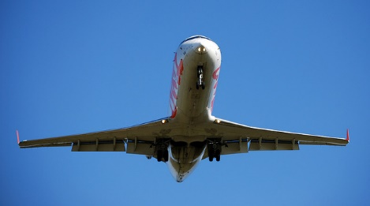
airports
There are around 12 airports in the Ottawa area

Slide 9
People in Ottawa
Nice
Some friendly
Some kind

Slide 10
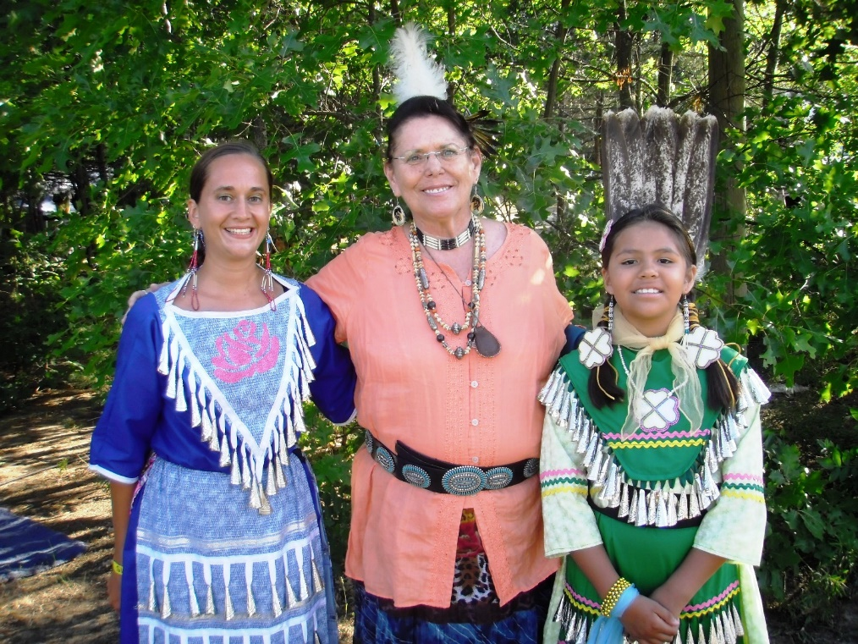
Interesting Facts
Ottawa was named after the tribe that first lived there. They were called the Odawa tribe.

Slide 11
By Vivian

