Slide 1
Toronto
Toronto is the capital city of Ontario

Slide 2
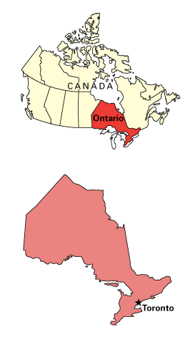
Where is Toronto ?
Toronto is in St. Lawrence lowlands.
It is In the south of Ontario.

Slide 3
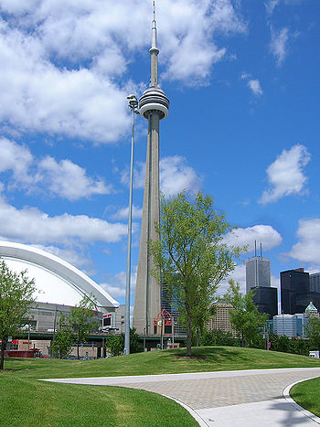
The CN tower height is.
55 333 m high from the base to tip.
Toronto has a restaurant inside the CN tower.

Slide 4
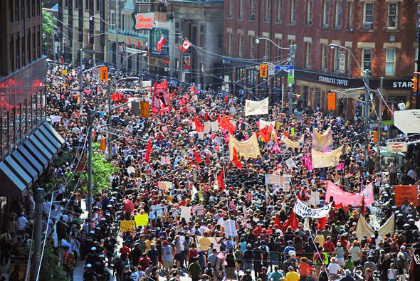
Populating in Toronto.
2.5 million people live in Toronto

Slide 5
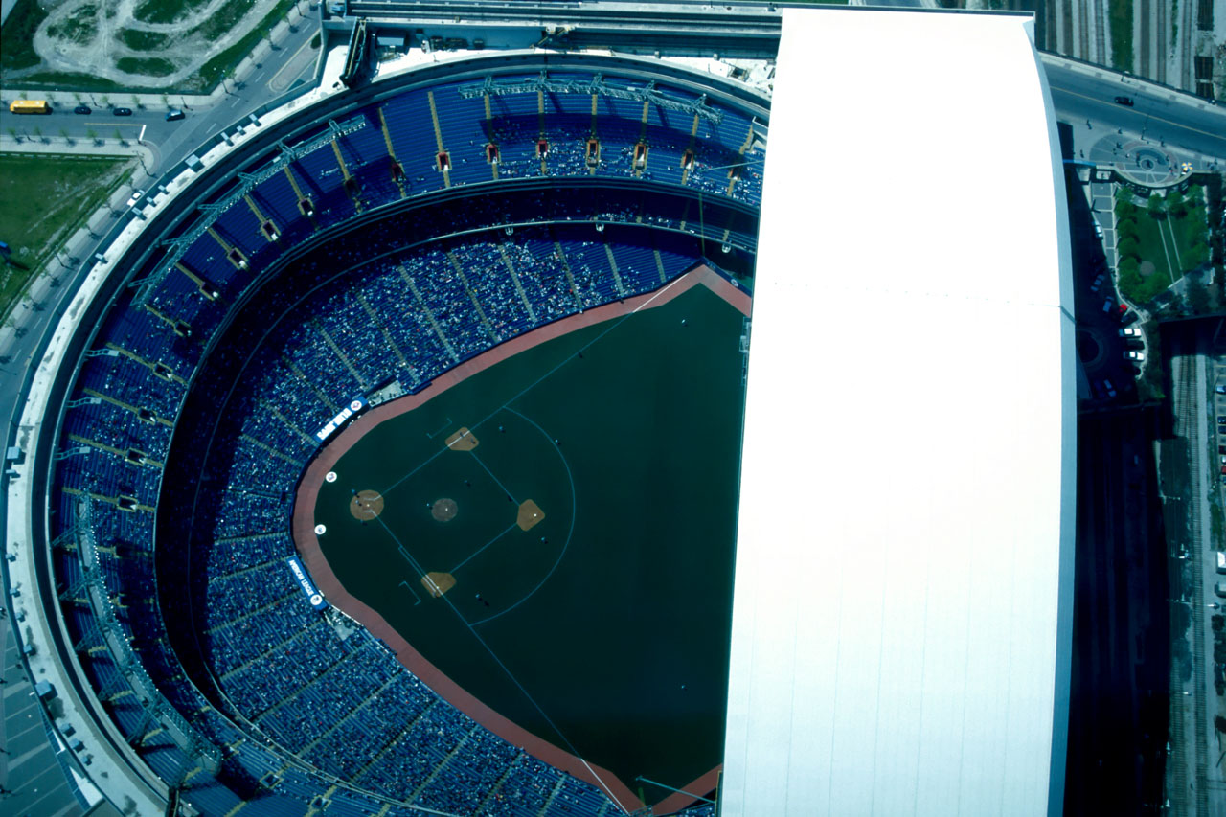
The sky dome has…
50.000 seats in the sky dome

Slide 6
Toronto has sick kids hospital.
When you turn 18 you go to Toronto general hospital.

Slide 7
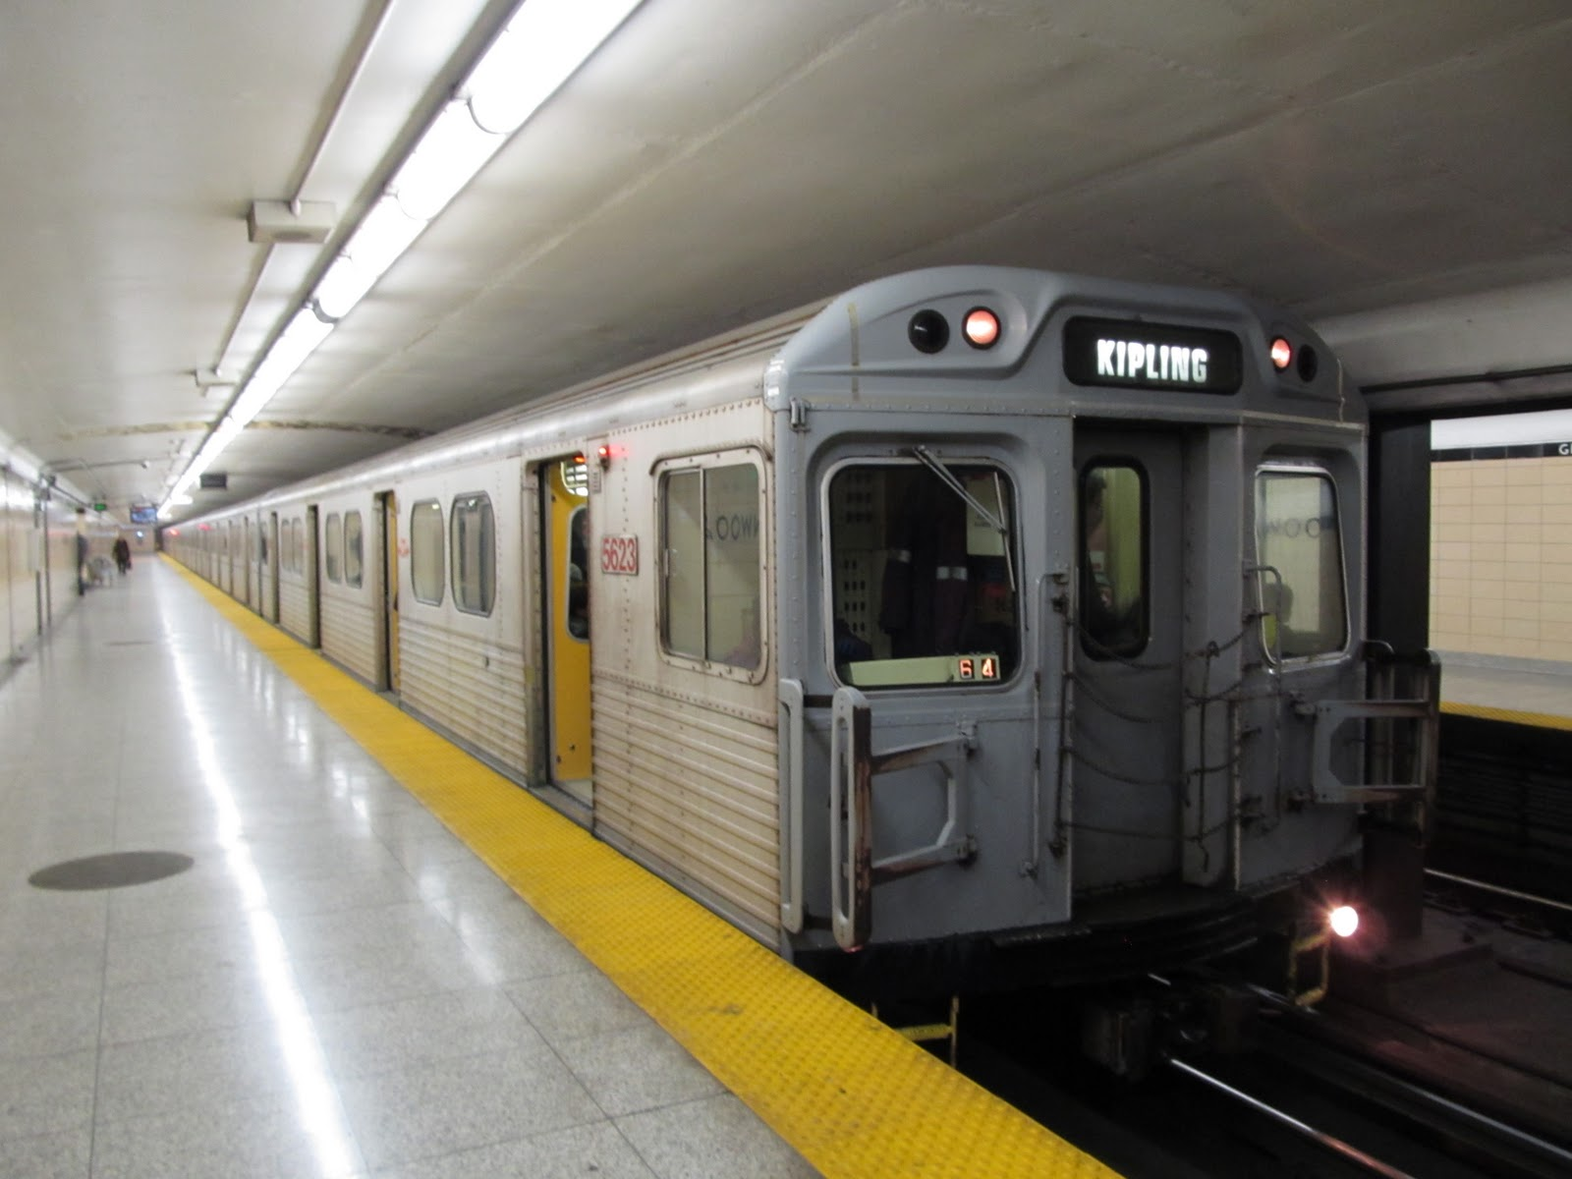
TORONTO HAS THE SUBWAY.
The subway is a train that runs
under the city.

Slide 8
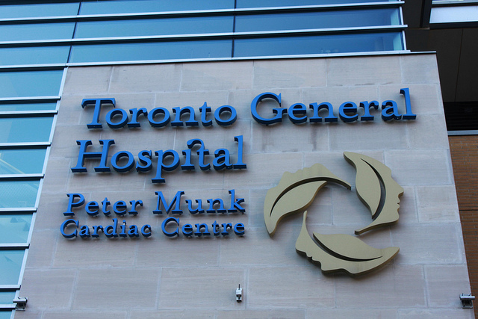
Toronto has…
There are over 30
Hospitals in T.O.

Slide 9
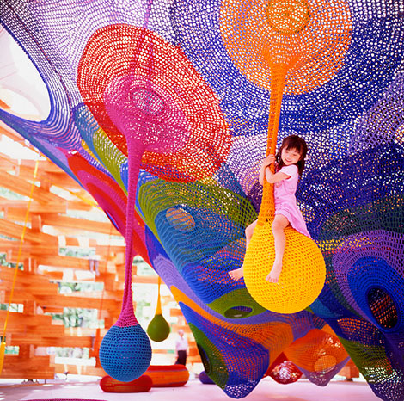
Toronto has…
100 parks

Slide 10
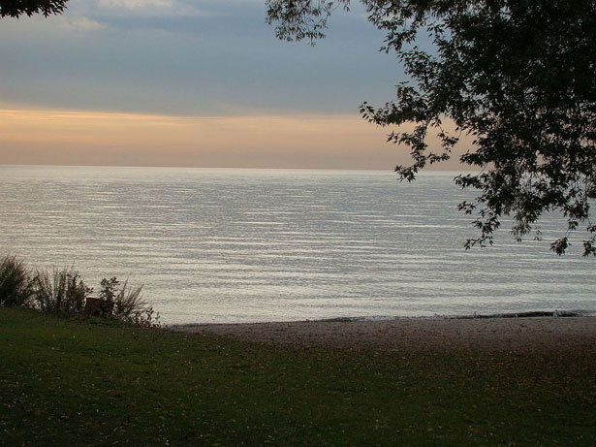
Toronto has…
Lake Ontario

Slide 11
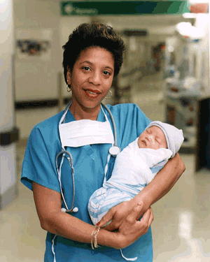
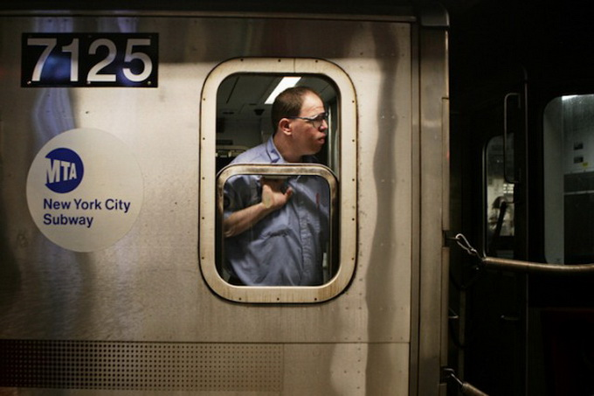
Jobs in Toronto
Nurses and, driving the subway, and
OPP, and many more. Businesses and office workers work in the big sky scrapers.

Slide 12
And that is Toronto

Slide 13
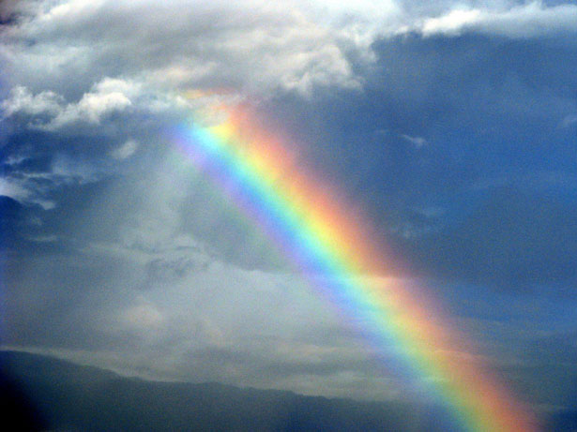
By Elizabeth and gabby

