Slide 1
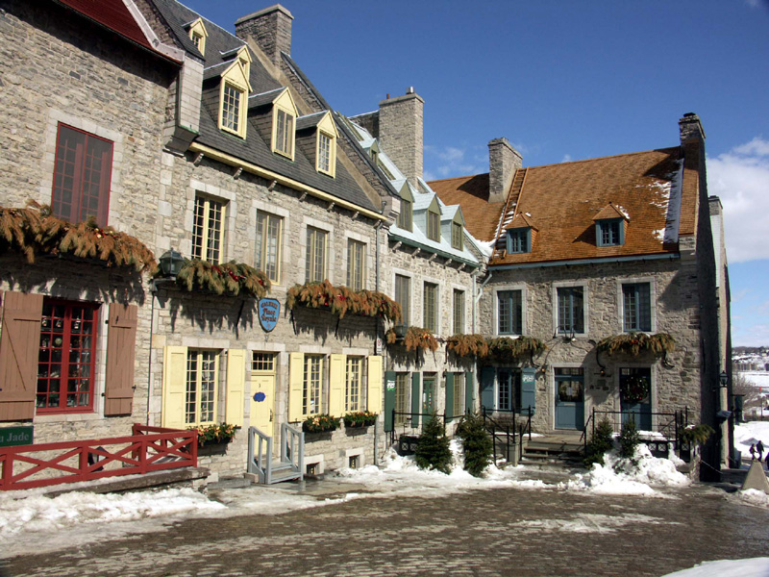
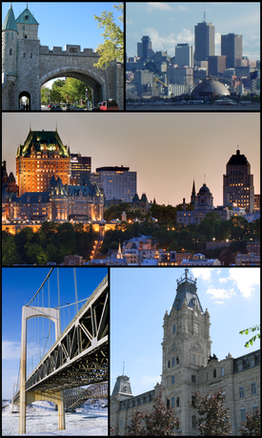
Quebec
The population in Quebec is
8 130 000 .

Slide 2
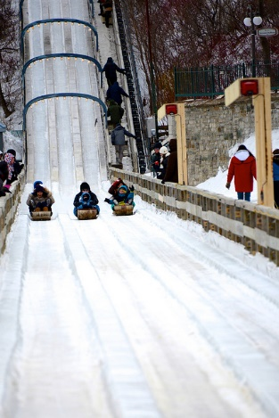
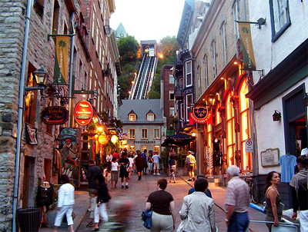
Quebec
The climate in Quebec is very hot in the summer with highs of 25 degrees Celsius. In winter it is snowy and cold with lows of -17 degrees Celsius.

Slide 3
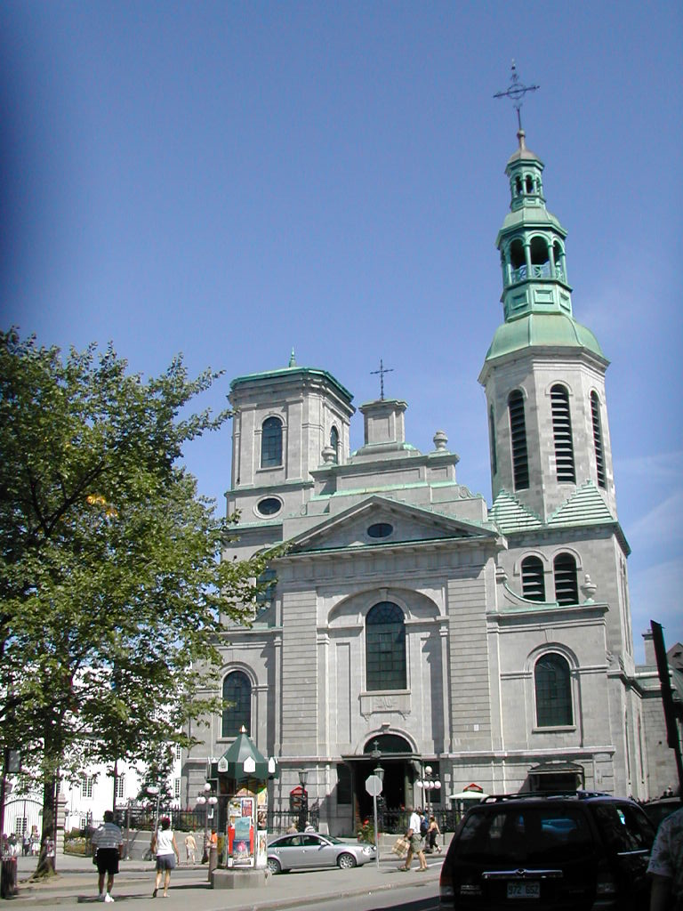
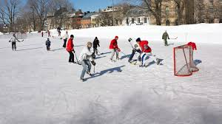
This is a Quebec church .
Skating on an outdoor arena

Slide 4
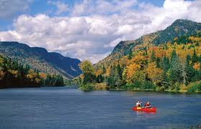
Quebec is part of the Canadian Shield so there is rocky areas and forest

Slide 5
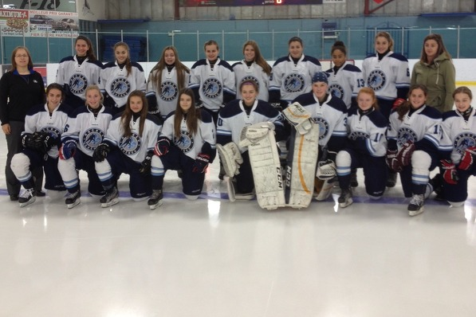
This is two Quebec hockey teams

Slide 6
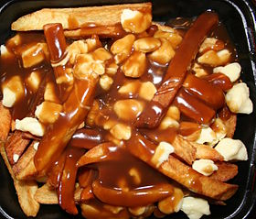
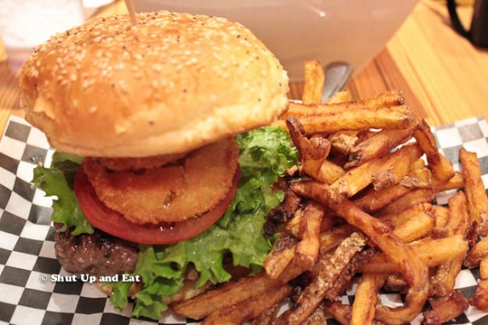
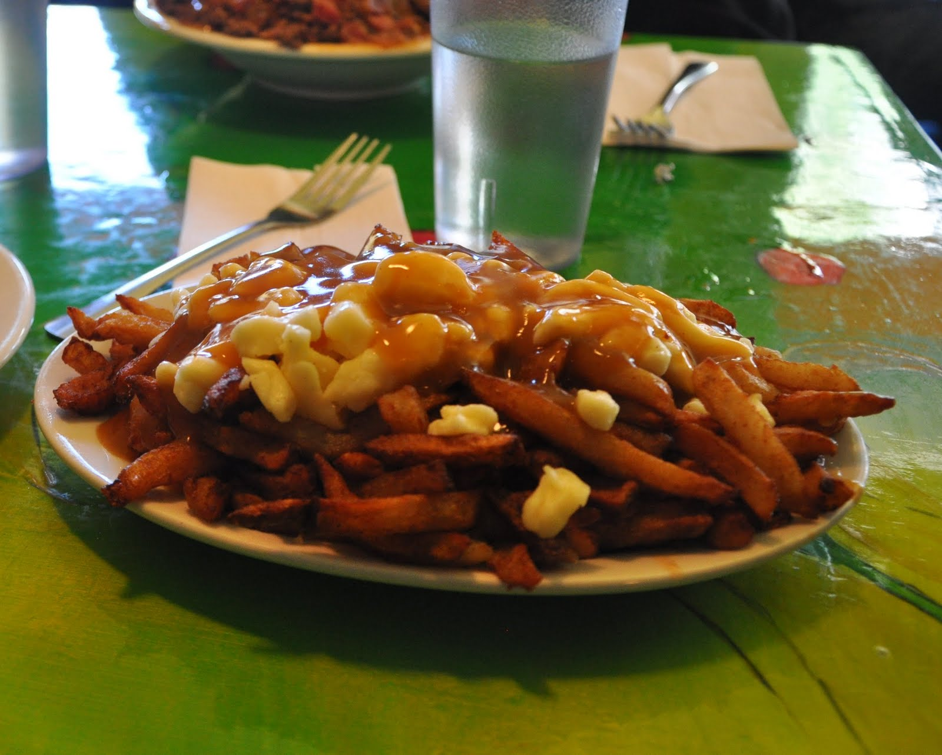
THIS IS Quebec food. Poutine is famous in Quebec

Slide 7
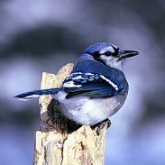
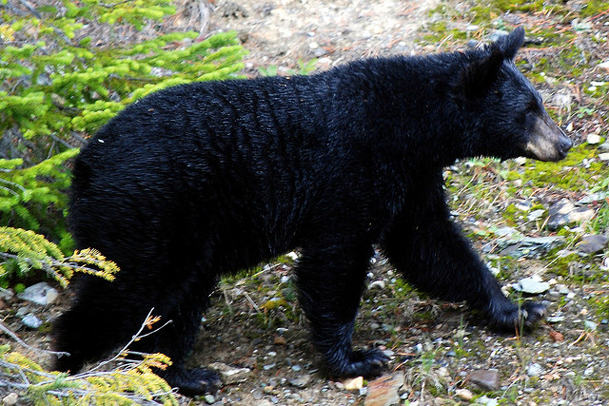
Quebec has lots of animals .

Slide 8
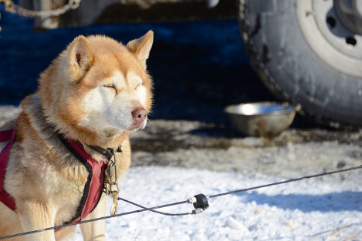
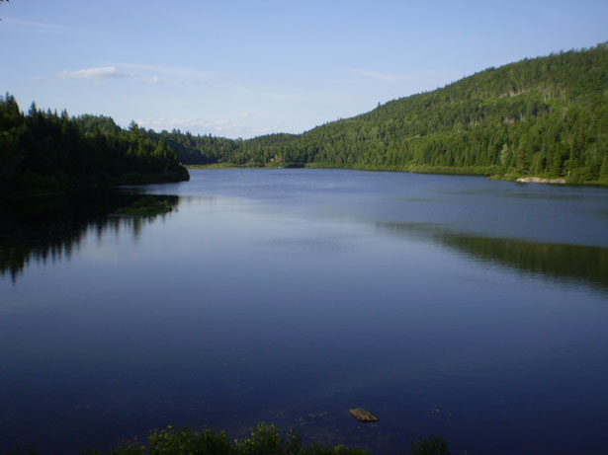
This is a Quebec sled dog
This is also a Quebec lake

Slide 9
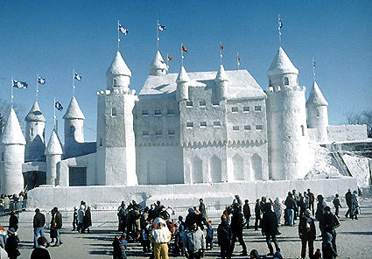
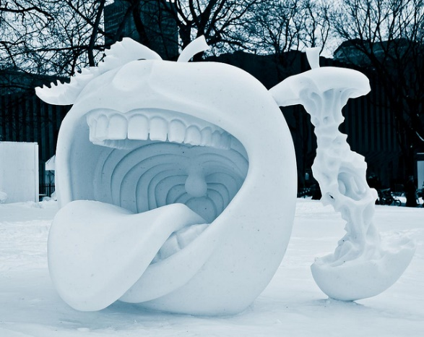
This is two of Quebec snow sculptures is n’t it awesome

Slide 10
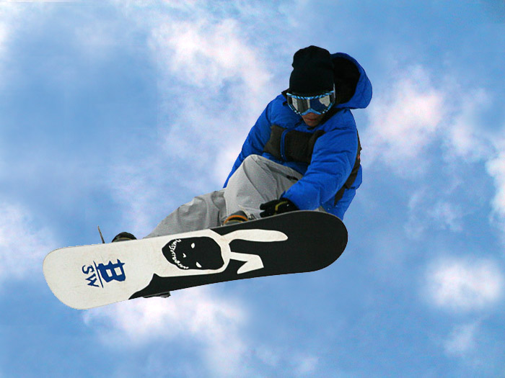
This is 1 of the
Most famous
Quebec snow
Boarders .
Indrik Trahan
Trois-Rivières, QC

Slide 11
By
Gerred
The END

