Slide 1
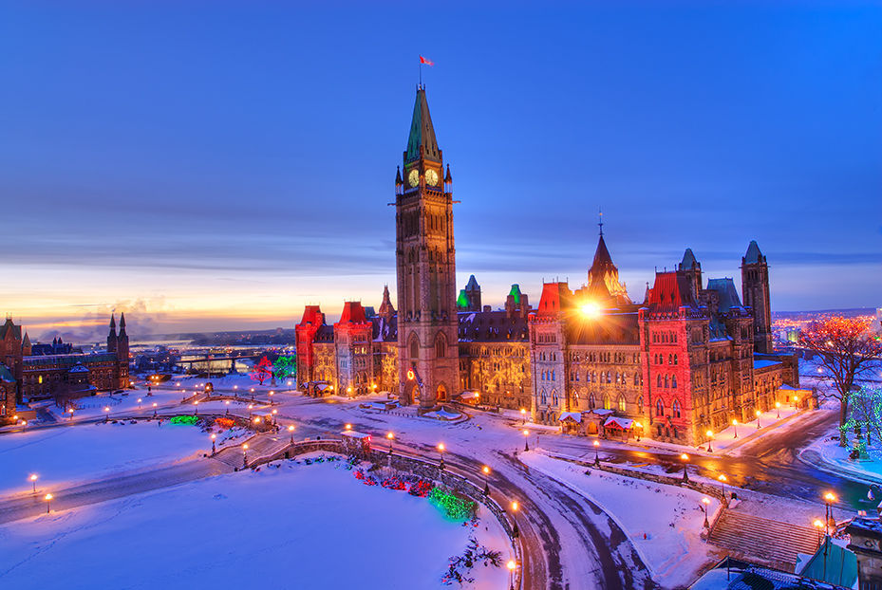
Ottawa

Slide 2
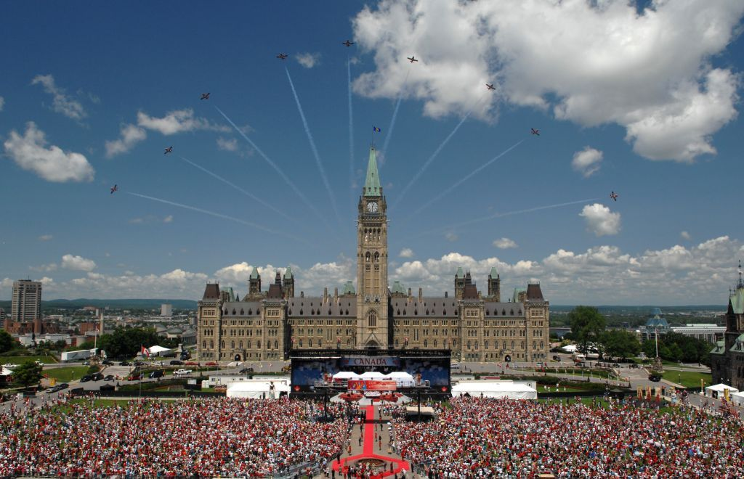
Population
The population is 1,282,500 people in Ottawa.

Slide 3
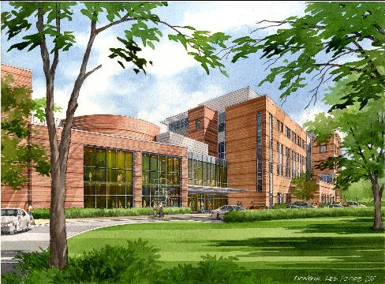
Schools
There are 117 schools in Ottawa.

Slide 4
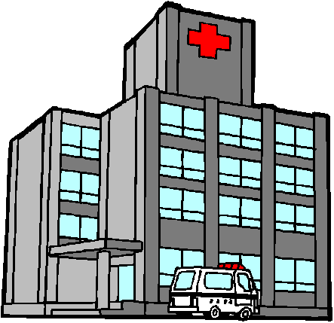
hospitals
There are about 5 hospitals in Ottawa.

Slide 5
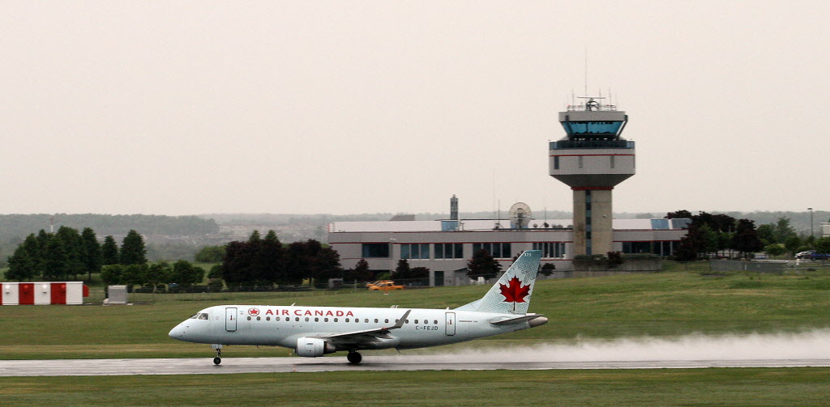
airports
There are about 12 airports in Ottawa.

Slide 6
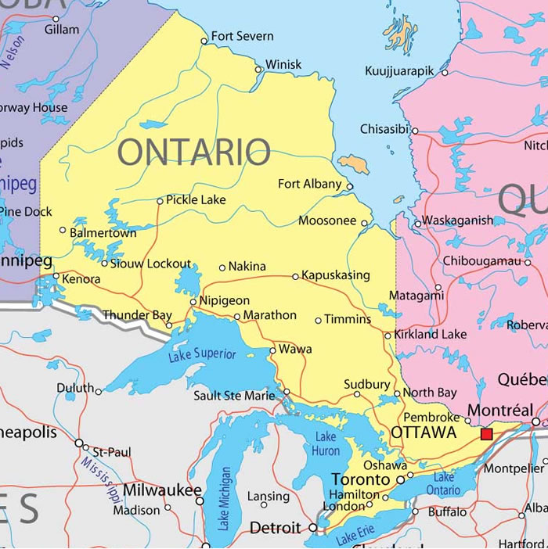
Where is Ottawa?
Ottawa is in the St. Lawrence Lowlands. Ottawa is where the red square is.

Slide 7
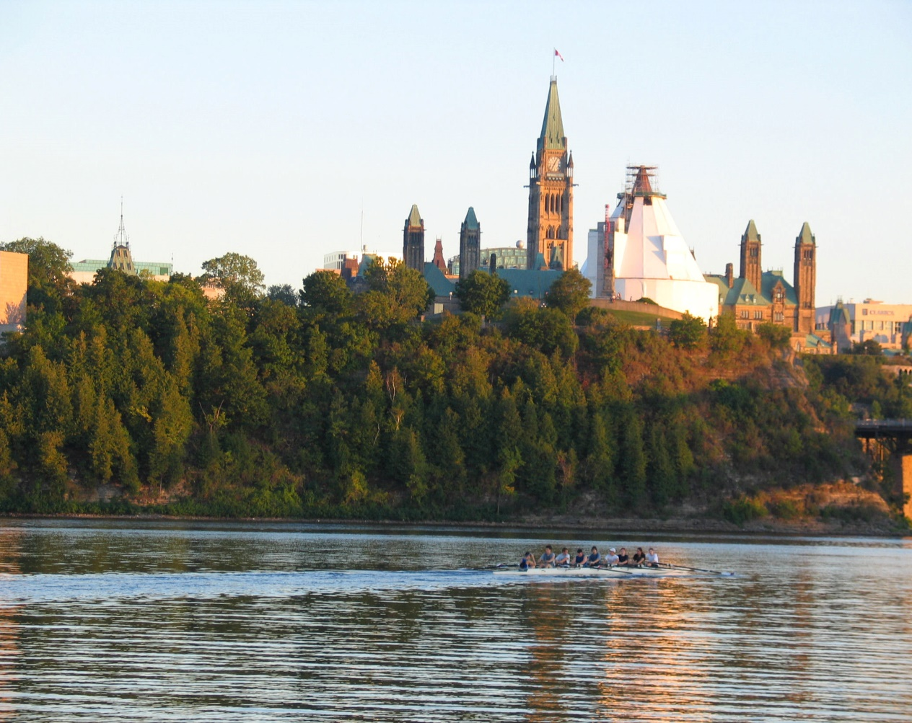
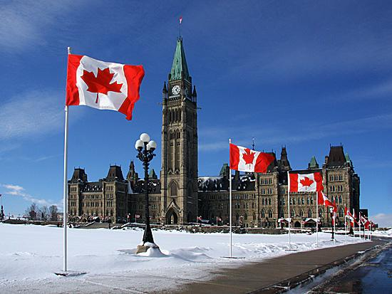
Climate
The climate of Ottawa in summer is plus 26 Degrees Celsius and in winter it is minus 14 Degrees Celsius.

Slide 8
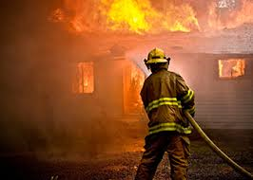
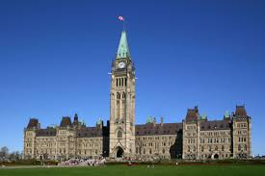
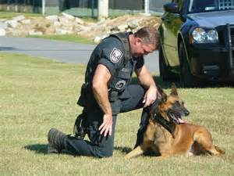
Jobs
The most important jobs in Ottawa are governor, police, fireman/women and lots more.

Slide 9
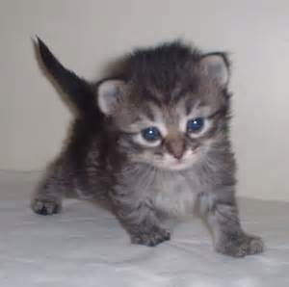
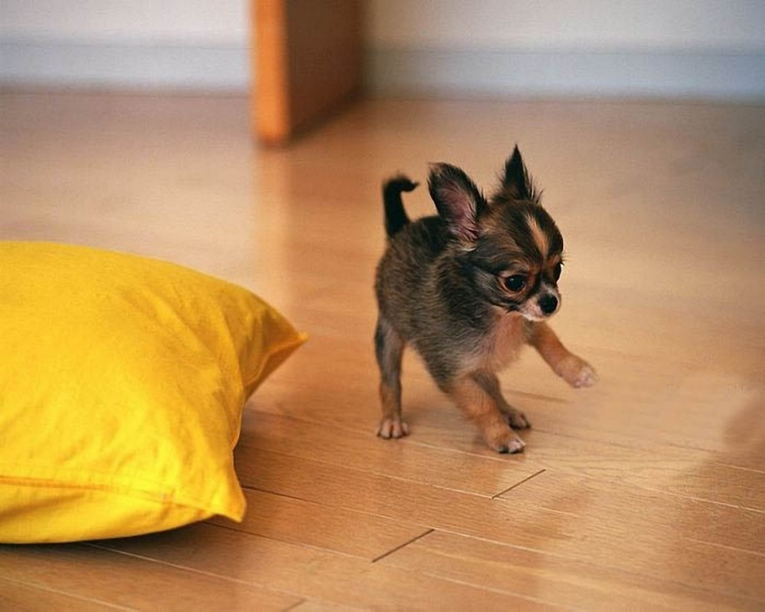
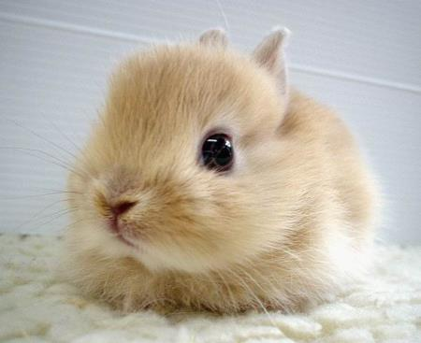
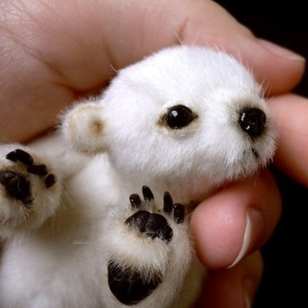
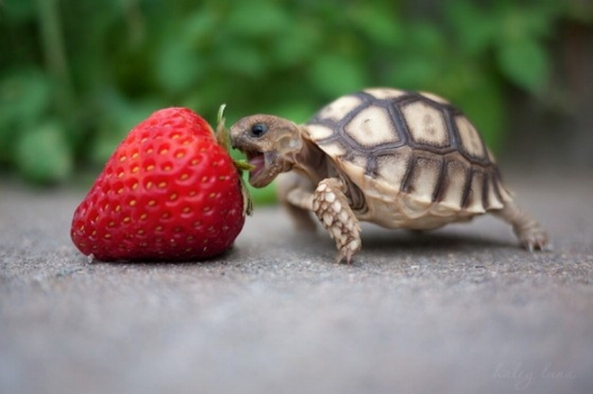
By: Lyla and Lauren!!!
This power point is by us.
We love animals!
P.S these are not animals from Ottawa

