Slide 1
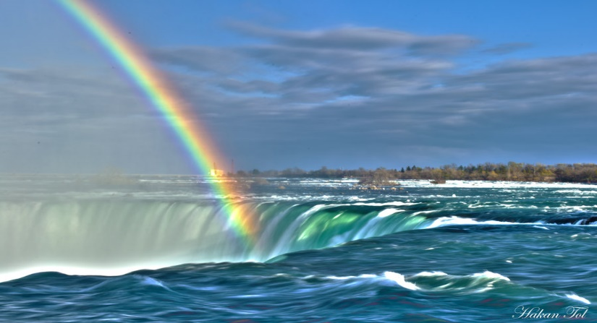
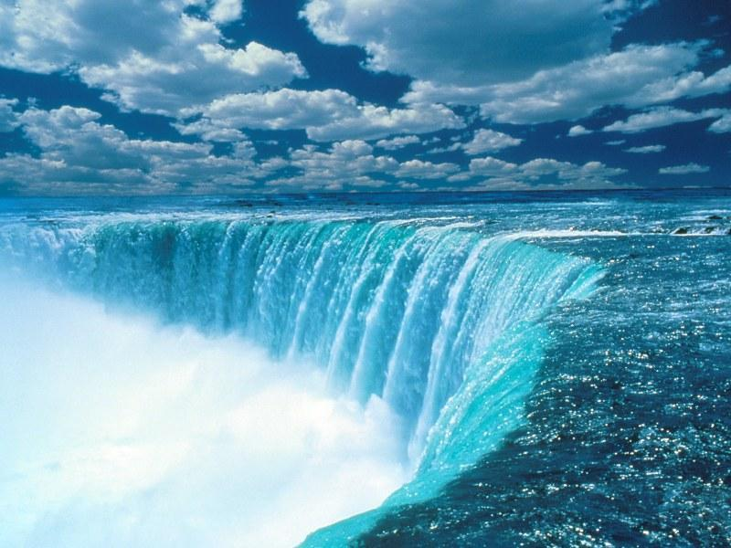
Niagara falls
The falls

Slide 3
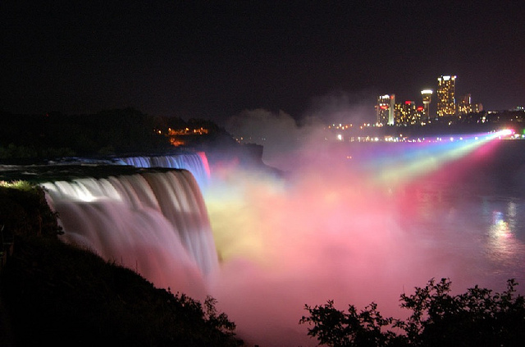
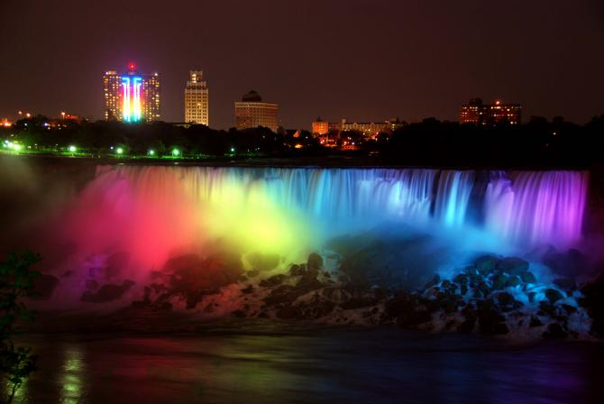
Niagara falls at night
Do you know why Niagara falls has lights at night on the water? This is because its for decoration and it could also mean that it’s a special day.

Slide 4
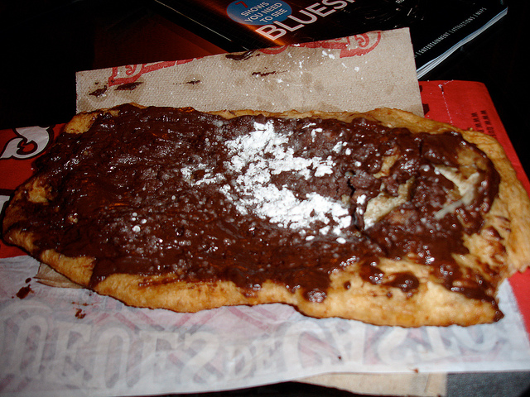
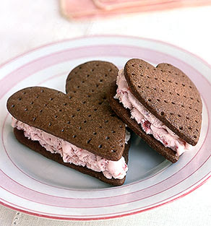
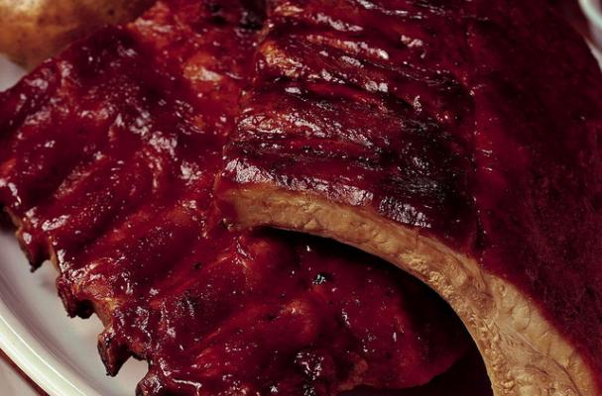
Food in Niagara Falls
Some of the foods you want to eat when you are in Niagara Falls are ribs, beaver tails and ice-cream and lots more.

Slide 5
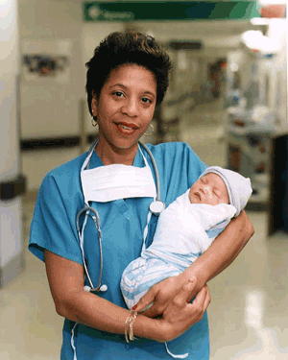
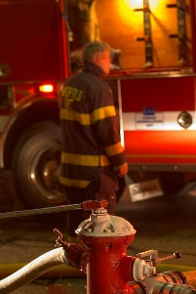
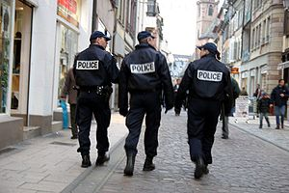
Niagara falls jobs
There are so many jobs to choose from like police, nurses, firefighters, farmers and tourism.

Slide 6
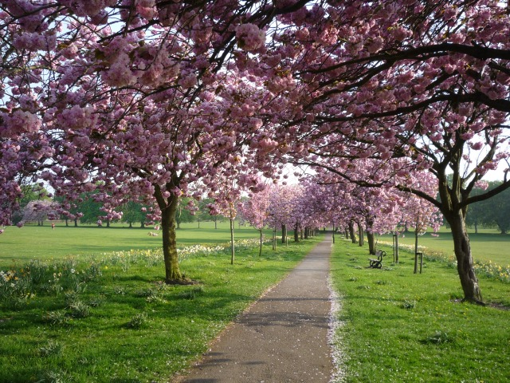
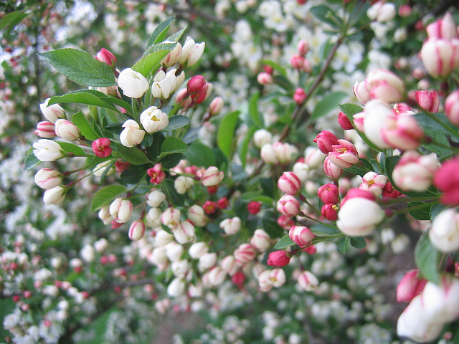
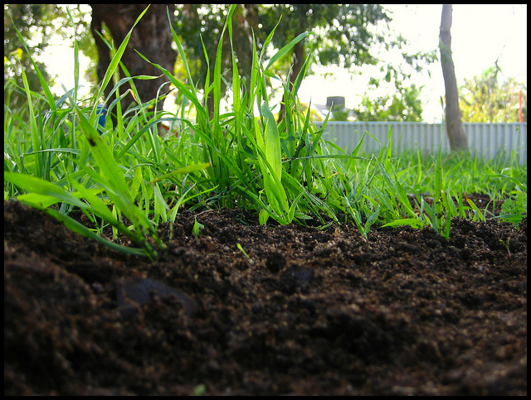
Industry in Niagara Falls
There are so many apple trees and cherry trees one of the reasons is that Niagara falls is in the St.Lawrence lowlands and it is known for having rich soil.

Slide 7
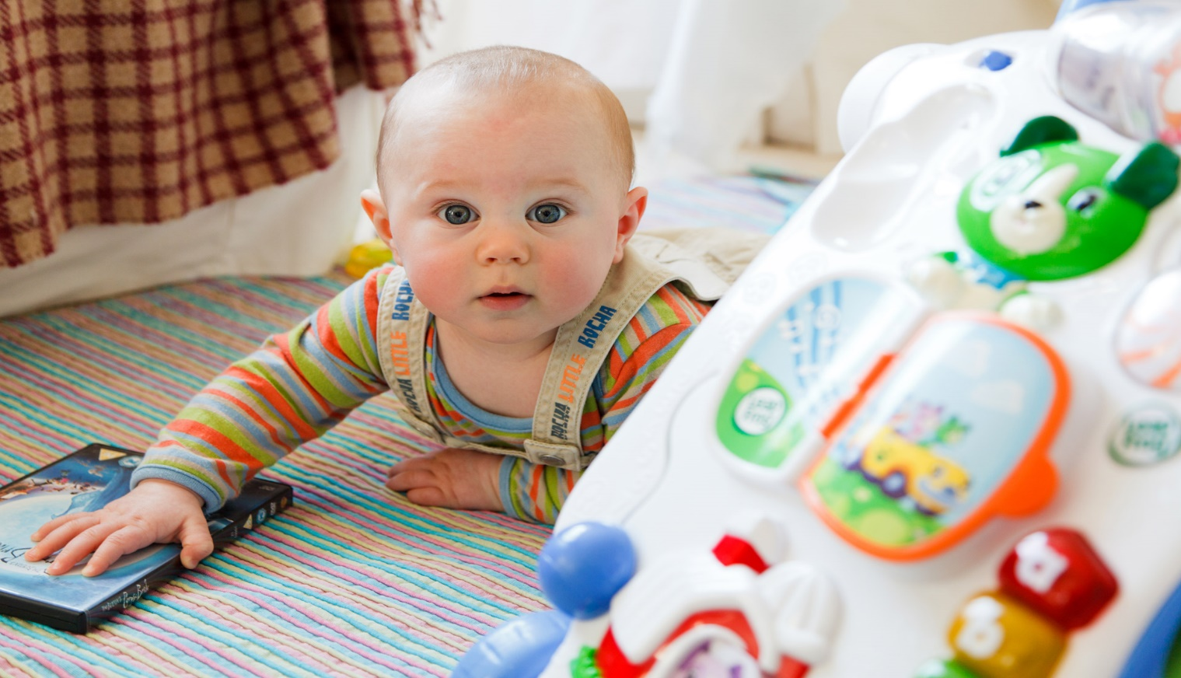
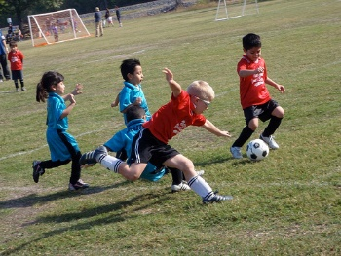
Population of people
The population of Niagara falls is 82 997

Slide 8
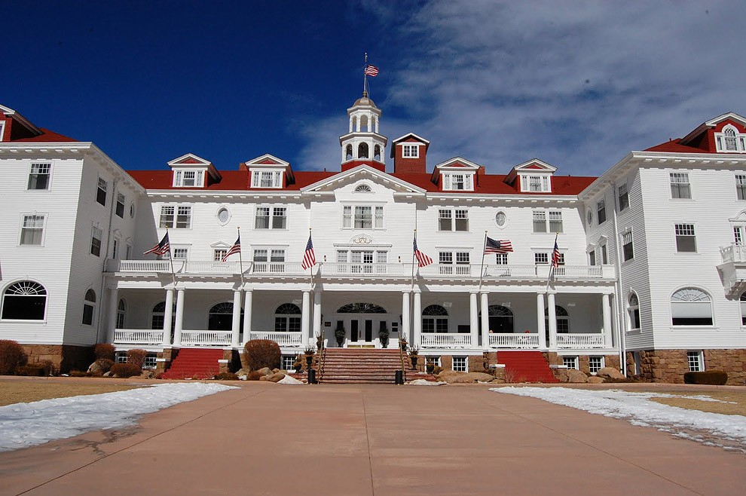
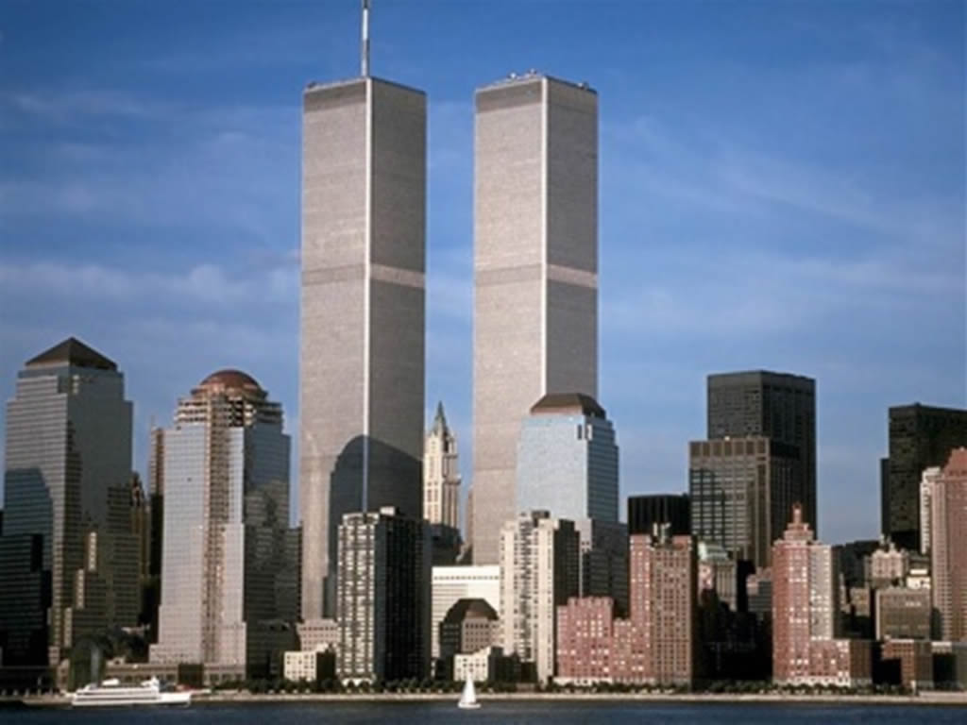
buildings in Niagara falls
There are so many buildings in Niagara falls and there are also lots of hotels or motels.

Slide 9
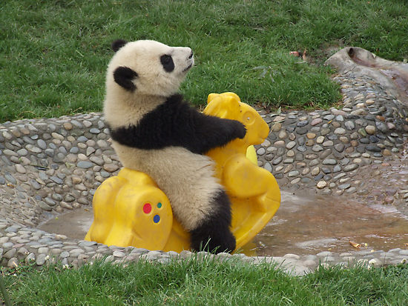
Made by ANNIKA AND KEZIAH

