Slide 1
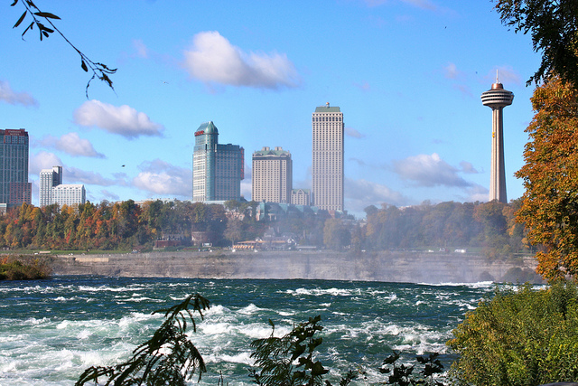
Welcome to Niagara falls

Slide 2
Where is it?
.Niagara falls is a city that is in South East Ontario
The famous waterfall is in the city. It is called Niagara Falls.
It is in the St. Lawrence Low Lands. This area has good soil for growing crops.

Slide 3
How tall is Niagara Falls?
Niagara falls is 51m high

Slide 4
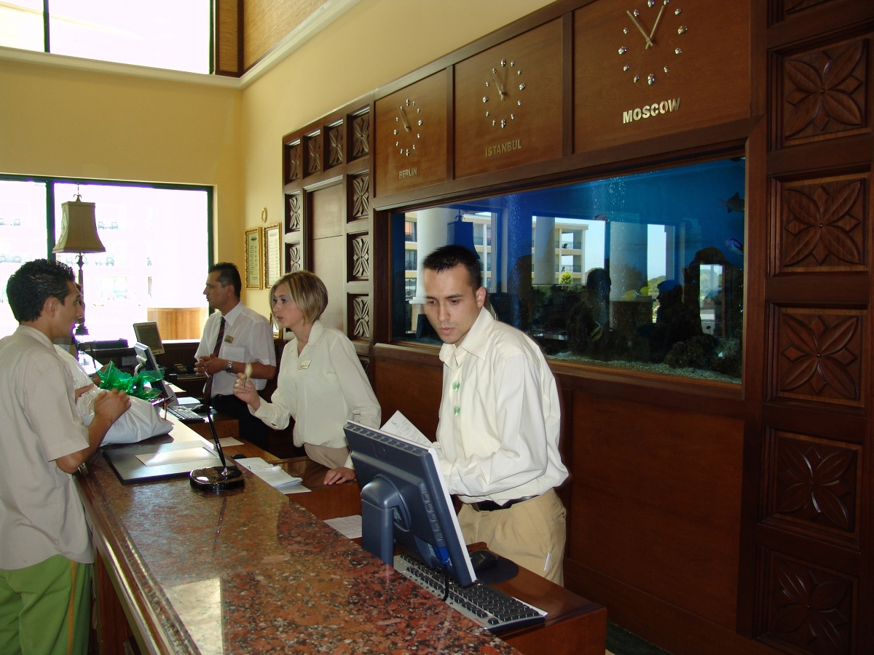
What type of jobs are in Niagara Falls?
Making apple products
Farming
Restaurant workers
Hotel managers and workers

Slide 5
Population
The population of Niagara Falls has 82 997people

Slide 6
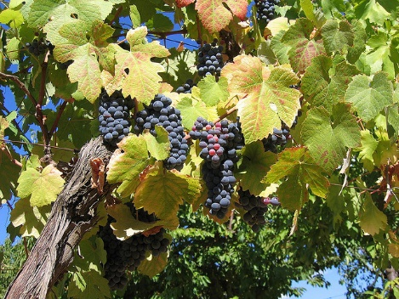
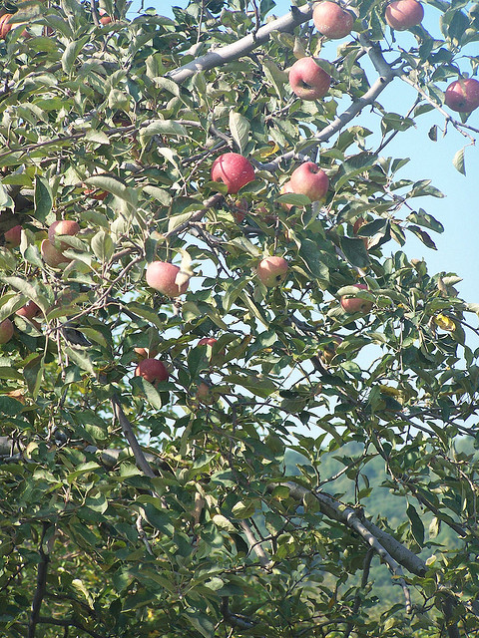
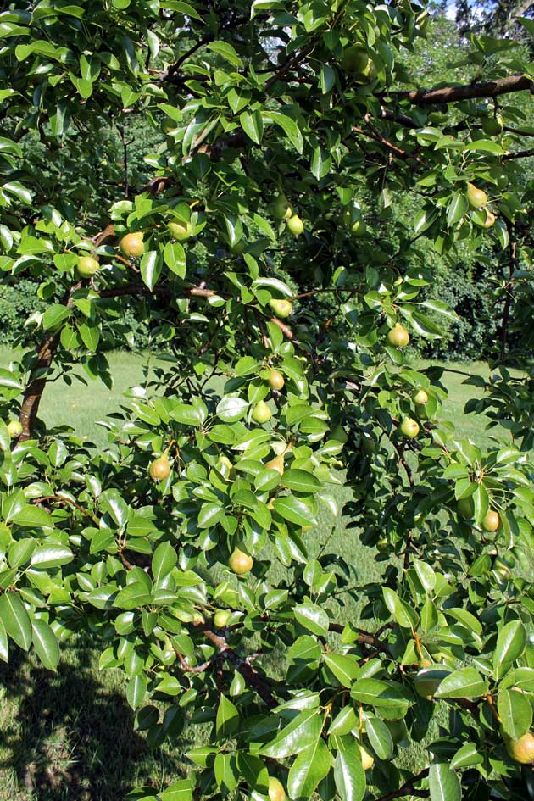
Industry
Niagara falls has good farmland for growing crops. They grow lots of fruits like grapes, apples and pears.
Tourism is another way that Niagara falls makes money. Lots of people come to visit Niagara Falls.

Slide 7
Niagara falls at night Niagara falls at night is very beautiful.

Slide 8
THE END
By Nathan

