Slide 1
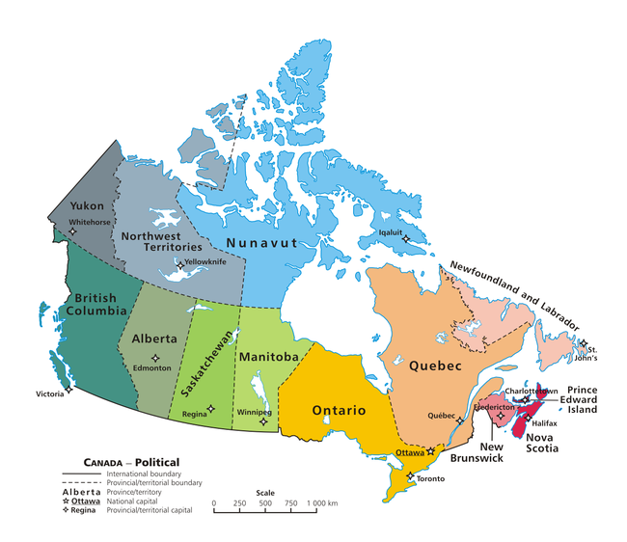
British Columbia
By Alex Stanley

Slide 2
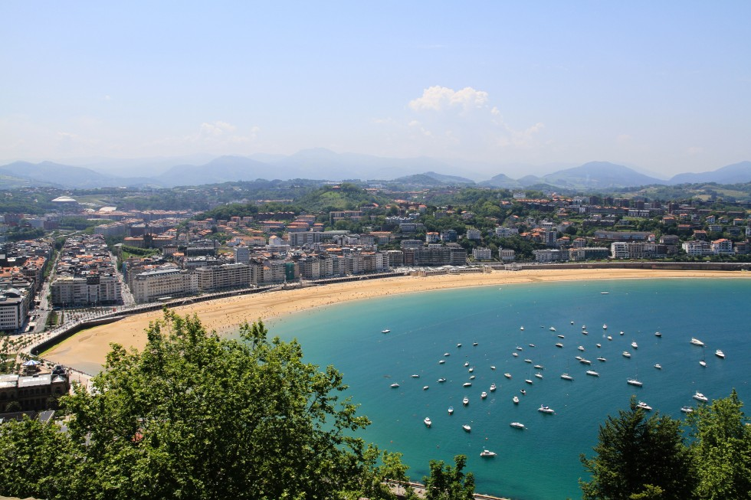
Climate
It`s warm in the summer with highs of 25 degrees celsius. It`s cold in the winter with lows of -5 degrees celsius. If snow falls it doesn't stay long.

Slide 3
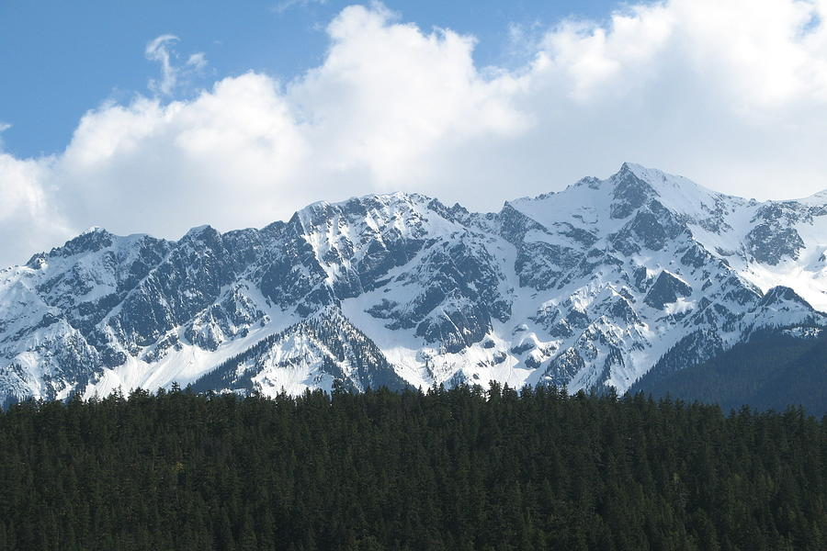
Land
There are rocky mountains in British Colombia. There are 10,000 mountains. It is part of the Cordillera. Which means it has mountains, trees, ocean and rocky cliffs.

Slide 4
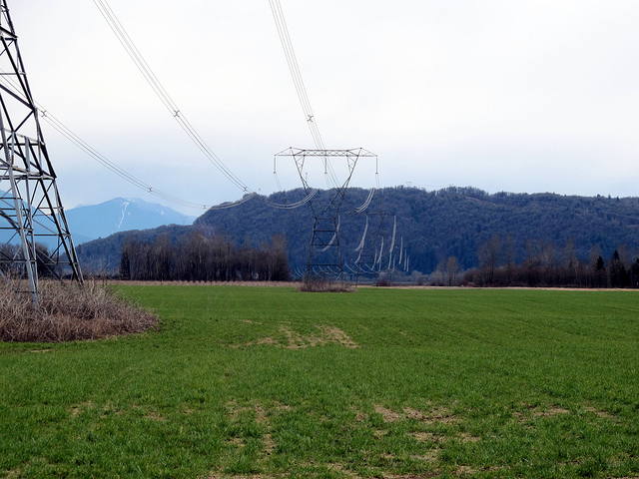
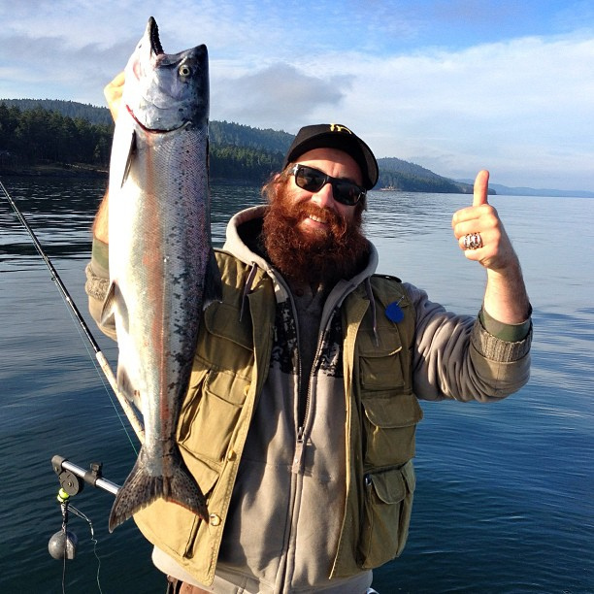
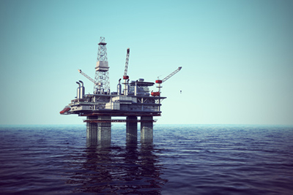
Industry
The major industries in British Columbia are gas, oil and hydro electricity. Fishing is very popular because it is on the Pacific Ocean

Slide 5
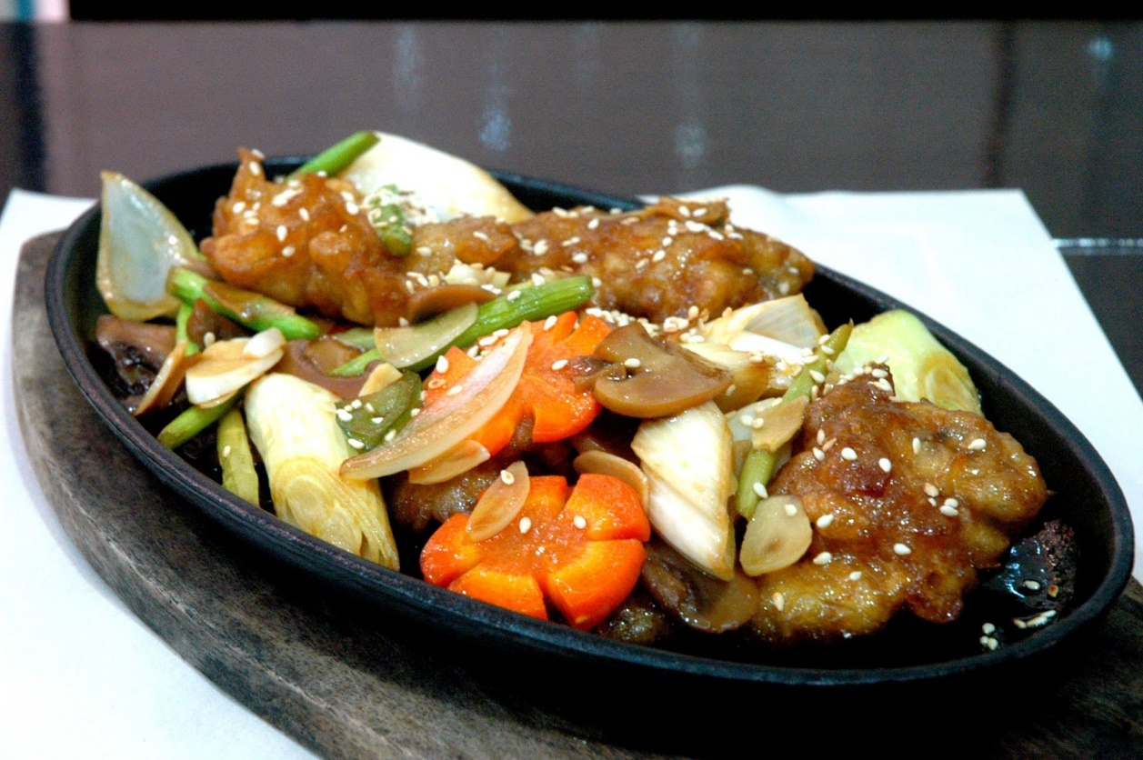
FOOD
You can eat shrimp, fish, mushrooms and many other stuff. This is popular because they are on the Pacific Ocean.

Slide 6
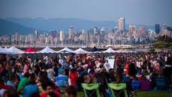
population
The population in British Colombia is 4 610 000.

Slide 7
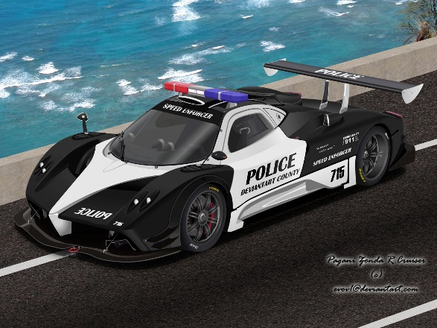
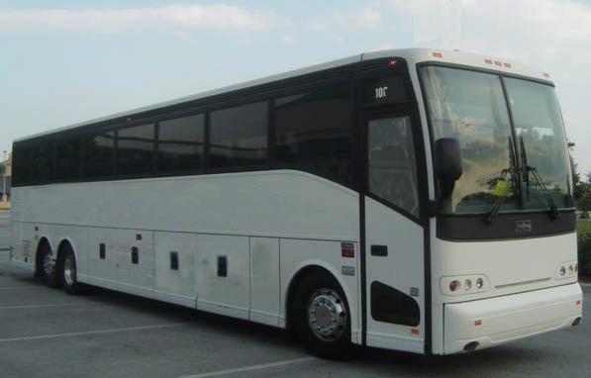
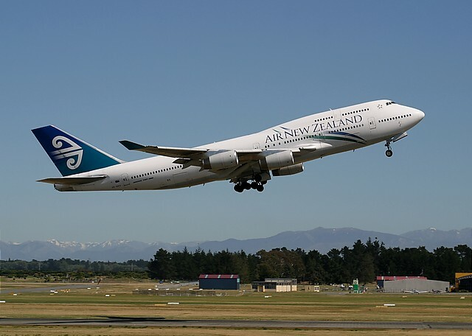
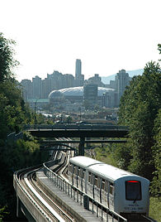
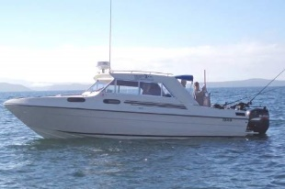
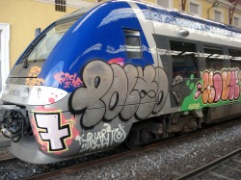
transportation
You can get around in a car, bus, plane, Train and boat. They even have a sky train that goes above the city of Vancouver.

Slide 8
language
They speak English and Chinese.

