Slide 1
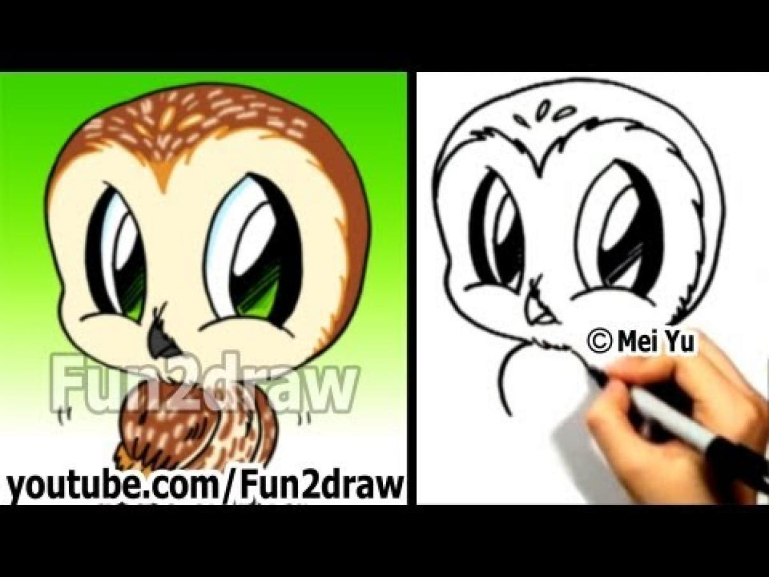
Owls
owls
By : Tristan

Slide 2
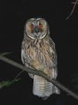
Owls are active at night It is called nocternal.

Slide 3
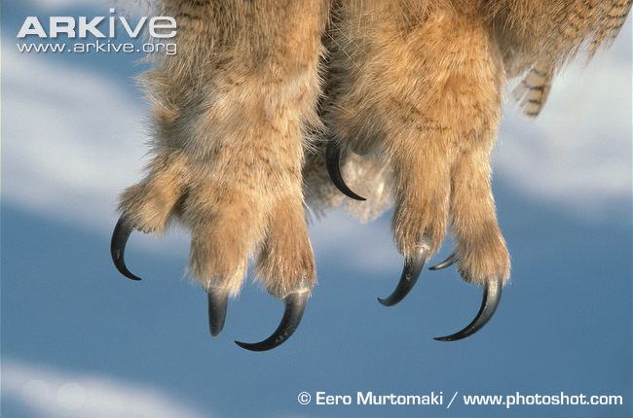
Owls have power full tallens (claws) wich help catch and kill
prey
There aroun 200! diferent owl Spicis

Slide 4
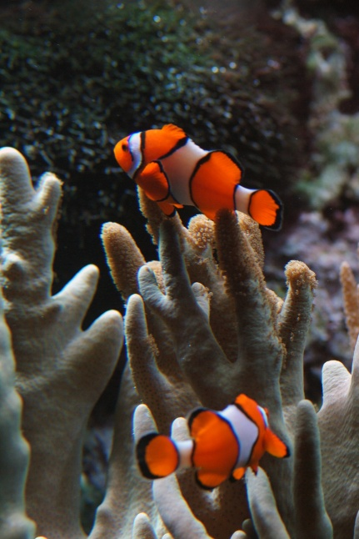
Some owl spicis eat fish
Owls have large eyes to see prey
From far away

Slide 5
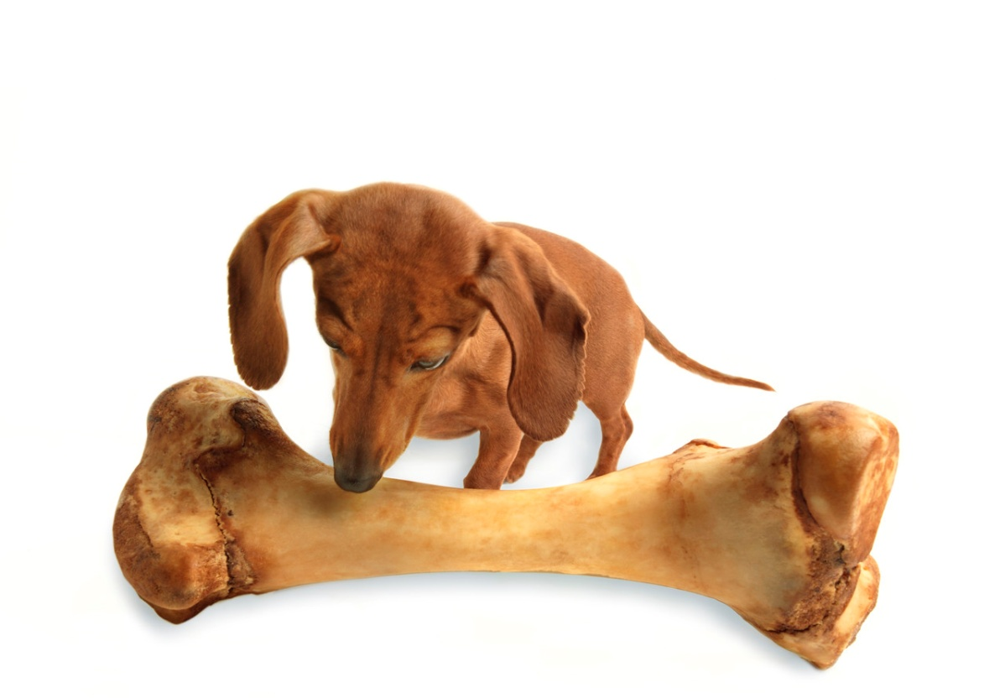
Owls can turn there heads 270 degrese
Most owls hunt insects, small birds & other small animals

