Slide 1
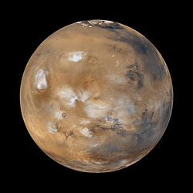
Why is Mars Red?

Slide 2
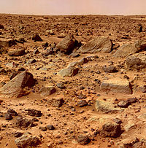
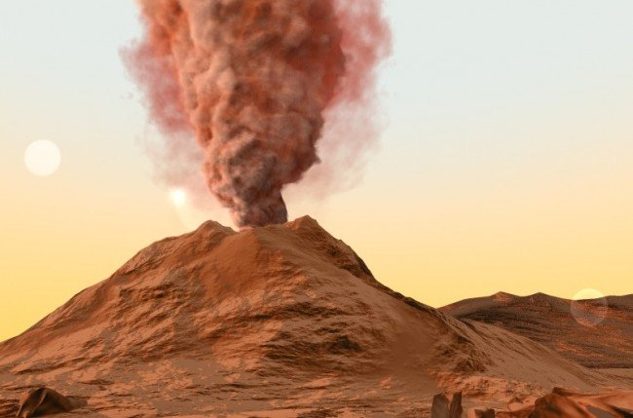
Mars is red because there are volcanoes on it.
It looks red from a distance because the dust from rocks is moving around mars.

Slide 4
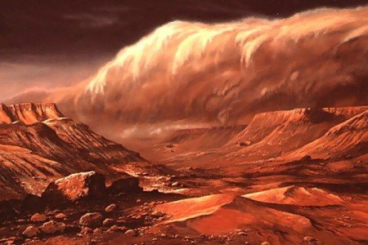
Mars
The dust covers the whole entire planet
The rocks on the planet sometimes break and the dust from the rocks gets carried away.

Slide 5
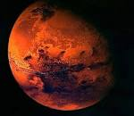
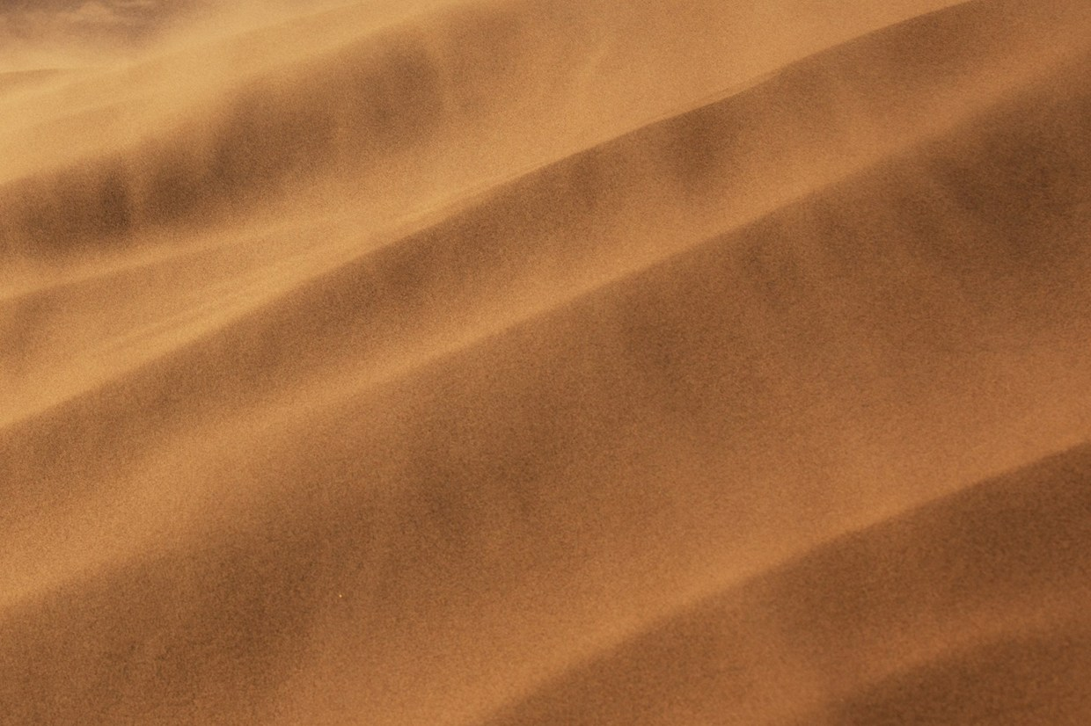
All it is rust from the rocks staying on the planet too long .
The real answer is just the rusty dust .

Slide 6
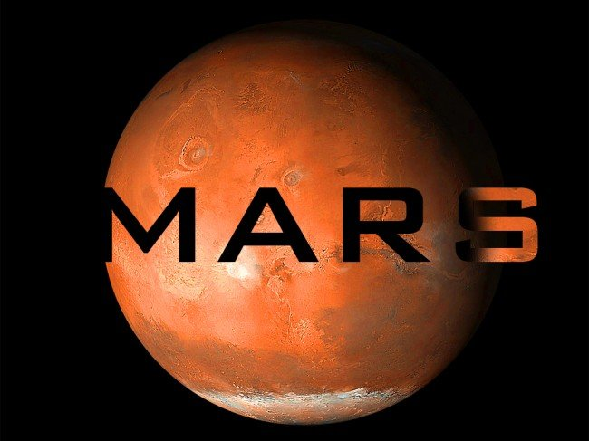

Slide 7
