Slide 1
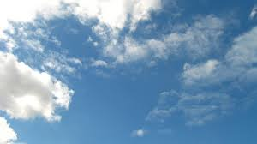
Why is the sky blue?

Slide 2
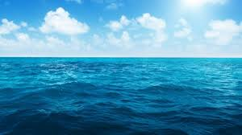
it is a reflection of the ocean

Slide 3
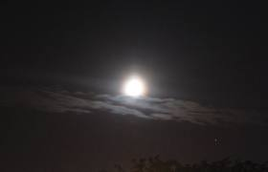
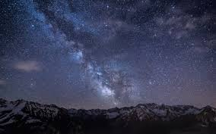
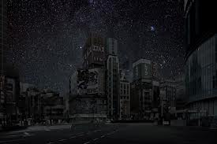
Pictures of the sky if there was no atmosphere
If there was no atmosphere it would be dark day and night

Slide 4
Why the sky is blue and the sun is white
The sun is made out of all the color of the rainbow but mostly blue so the sky is blue. that’s about it! That is why the sky is blue.

