Slide 1
How did baseball pitchers throw so fast.

Slide 2
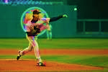
FAST THROWS IN MLB.
BACK HAND
TWIST HAND
OVER HAND

Slide 3
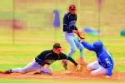
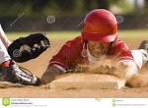
CHANGE UP.
SLIDER
FAST BALL

Slide 4
ENERGY IN PITCHERS.
BASSBALL PITCHERS NEED ENOUGH HEALTHY FOOD TO THROUGH FAST IN BASEBALL.

Slide 5
PRACTICE OF BASEBALL.
BASEBALL PITCHERS NEED LOTS OF PRACTICE TO THROW FAST IN MLB.

Slide 6
Width TO THROW
IN BASEBALL YOU NEED TO BE 1 2 INCHES TO THROW THE BALL.

Slide 7
BASEBALL STANS
IN BASEBALL PITCHERS NEED TO DO A BACK STANS.

Slide 8
THE END
THIS IS THE END OF THIS pptx

