Slide 1
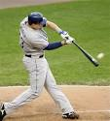
How do people hit the ball so far in baseball.

Slide 2
Fast ball has a smooth hit.

Slide 3
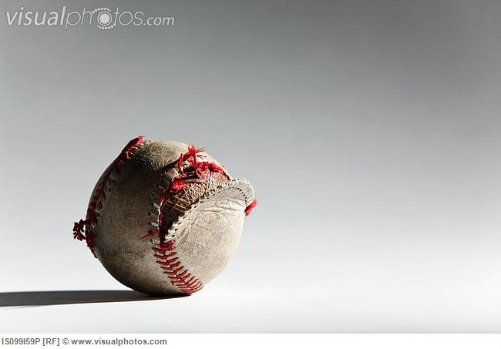
If you hit the ball hard enough it could braek.

Slide 4
Fast ball
Rotation=8 speed=88

