Slide 1
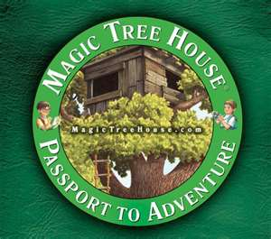
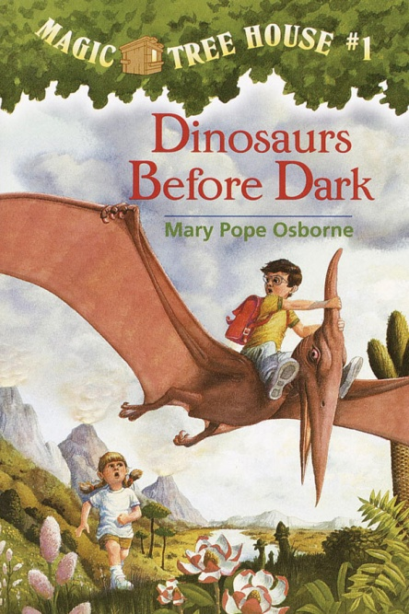
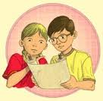
Dinosaurs Before Dark
by Mary Pope Osborne

Slide 2
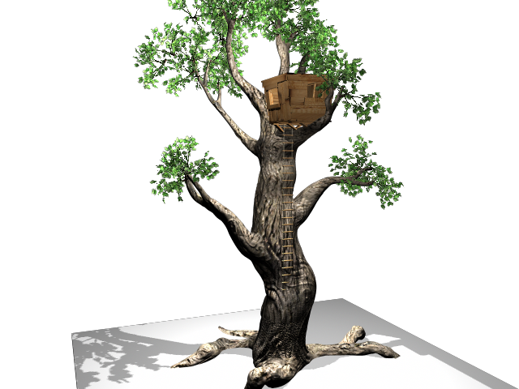
Characters
There are two amazing characters (humans) in this book . Jack is eight and a half . He has brown hair with glass’ . Jack liked to read . He liked real things. Unlike his seven year old sister Annie. She has blonde hair put in pony tails and likes to pretend . Of coarse there are dinosaurs or it would not be called Dinosaurs Before Dark .

Slide 3
What Is The Tree House Doing Here?
One day Jack and his sister Annie find a tree house filled with books . Before they know what is happening the tree house whisks them away to the time of the dinosaurs . Can they get home before dark or will they be a midnight snack ?

Slide 4
Where It Is .
It all starts in Frog Creek Woods where Jack and Annie found the tree house .Then they end up traveling to the time of the dinosaurs . When they got there they walk up a gigantic grassy hill and down to a earthy nesting site . The nesting site was filled with mother dinosaurs and there baby’s .

Slide 5
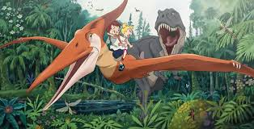
Favourite Part .
Personally my favourite part was when the Jack was running away from a terrible meat eating tyrannosaurus rex ! I was really wondering if he was going to be the dinosaurs dinner .

Slide 6
Recommendation .
This book is mostly an adventures fairy tale but there are a little bit of information about dinosaurs . If you like magic , adventures , chapter books and dinosaurs I would recommend this book to you .

Slide 7
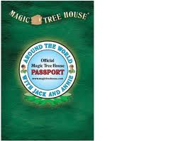
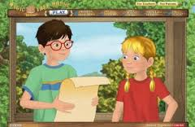
THE END !

