Slide 1
Vampire trouble
By Marcia Thornton jones and Debbie dadey.

Slide 2
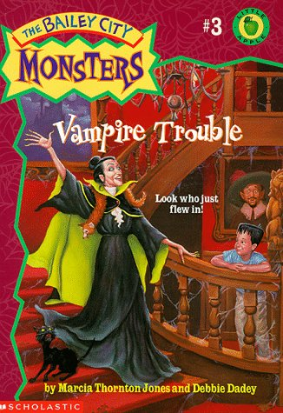
characters
Kilmer Jane ben Annie Madame hantley.

Slide 3
favorite
My favorite part was when there friend was marching down the streets with a sign that said go home vampires. Jane ben and Annie didn’t like it!

Slide 4
recommendation.
I recommend this book to you if you like monsters mysteries and adventures

Slide 5
About the book
This book is about three kids named Jane Ben and Annie where who find out that there is a new kid named kilmer the three kids think he is a monster.

Slide 6
The End
By Elissa

