Slide 1
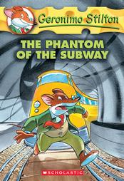
The phantom of the subway
Geronimo stilton

Slide 2
Characters
Geronimo Stilton
Thea stilton
Trap stilton

Slide 3
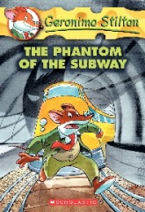
About the phantom of the subway
A phantom cat has been haunting the subways and Geronimo and his friends are trying to find out so they can put it in the news before sally his arch enemy that also runs a newspaper place too.

Slide 4
Recommendation
I recommend this for you because it is an interesting book lots of adventure. If you like adventure you should really read this. It is like they travel in the sewer and it smells really really bad!

Slide 5
The end
That is all I’m going to say
Because I want you to read
It.

