Slide 1
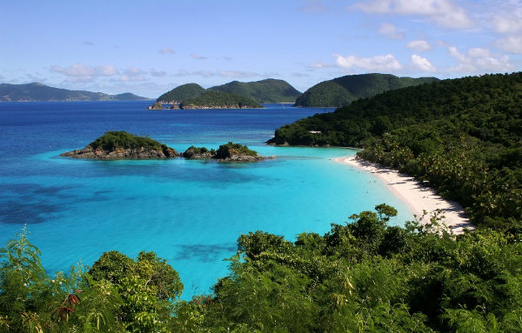
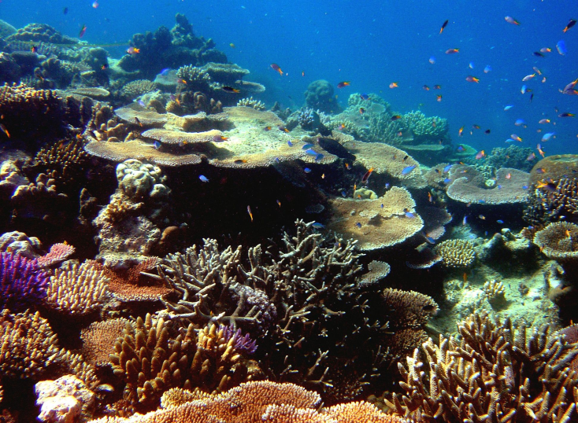
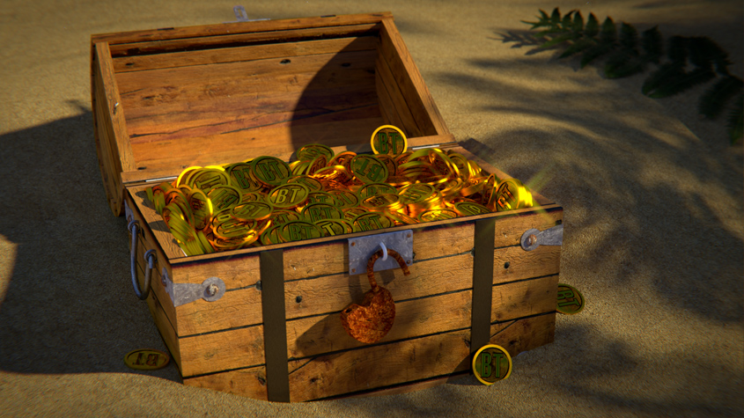
The secret of skeleton reef
By: Cameron

Slide 2
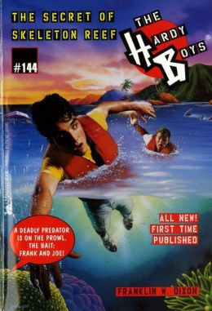
Information about the characters
Joe is a teenager that has a good eye for adventure
Frank is a teenager that finds allot of clues
Auntie Samantha is friends with the three boys and she likes helping them
Jamal is a teenager that is friends with the boys and also helps them

Slide 3
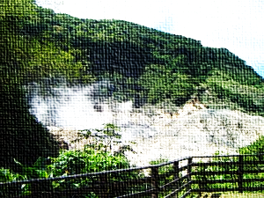
Facts about the hardy boys
Did you know Frank is 18 and very thoughtful?
Also, Frank lives in Bayport, a town on the east cost of United States.
Joe is a year younger then Frank, energetic and fair.

Slide 4
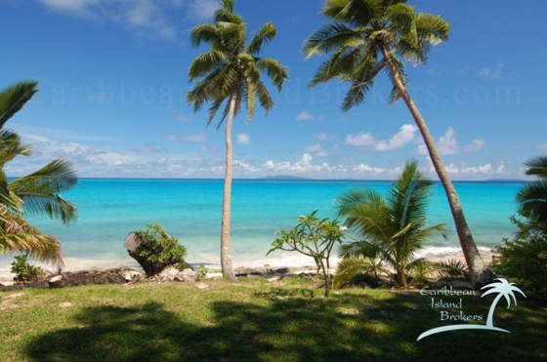
Setting
The setting of this book is the caribbean beach
Near lots of different resorts

Slide 5
Cool facts about the Caribbean
Here are some of the names of some different places in the Caribbean. Jamaica, Aruba, Barbados, Anguilla, Cuba, Dominican, Bahamas, Grenada and Trinidad.
The Caribbean is located south east of the gulf of Mexico.

Slide 6
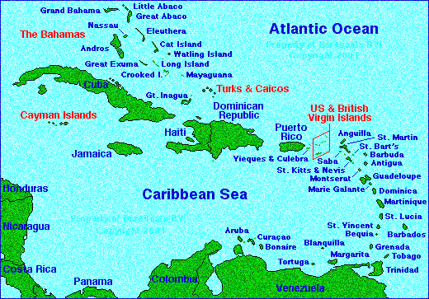
This a map of the Caribbean.

Slide 7
The Summary
This book is about two teenagers and one friend finding a ship. The crew on the ship tells them what they were looking for, which was the treasure of skeleton reef. Since they wanted to know more they went to auntie Samantha for more information. There, they found out that the treasure was plutonium. Then they went back to the ship. Suddenly some of the crew members turned against the Hardy boys. Eventually the Hardy boys were able to fight back and they got them trapped. After they called the police they came right away. The Hardy boys explained the crime and the police took them away. Later the Hardy’s just enjoyed their vacation.

Slide 8
Sneak peak chp.13 pg.115 Inside the volcano
Frank dropped to the ground. The spear fell several feet behind him. “What’s going on?” Joe asked, squatting beside his brother. “Someone over by the goats is shooting a spear gun at us,” Frank said urgently. “And careful, the spears are hard to see.” Shielding his eyes from the glare, Joe saw the three goats still grazing by the trees. All he heard was the buzzing of insects. Then the buzzing was mixed with a whizzing sound, and the next second Joe felt a prick on his forearm. A long metal spear slid onto the grass behind him. He had been grazed by the spear point.

Slide 9
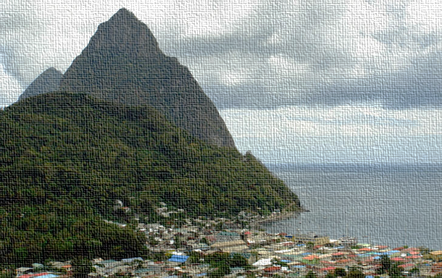
The end
Thank you for listening!

